Slide 1
[Community Logo]
[Community Name]
Notes:
Hello and welcome here is what we’ll do today…
NEXT SLIDE

Slide 2
REACH Program Overview
Workshop Objective
Learn more about sustainability & spread
Develop a plan to sustain REACH activities
Notes:
Hello and welcome here is what we’ll do today…

Slide 3
AGENDA
Time | Topic | Who
10:00 | Opening / Welcome / Introductions
10:15 | What is Sustainability & Spread
10:45 | Discussion
11:00 | Team Session –Sustainability Planning
11:45 | Closing

Slide 4
[insert community photo]
Elder Opening
[Name of Elder]

Slide 5
[QI Team Photo]
Introductions

Slide 6
Sustainability
Spread

Slide 7
What We’ll Cover
What is Sustainability?
What is Spread?
Factors for Sustainability and Spread
Sustainability and Spread Strategies
Case Study – The KSDPP
Planning for Sustainability and Spread

Slide 8
Spread and Sustainability
Quality Improvement is like a shark: to thrive, it has to keep moving forward
Improvements that are maintained produce lasting outcomes and over time result in healthier communities
An important part of QI is making sure your results continue by sustaining and spreading them

Slide 9
Spread and Sustainability
You are now the QI experts in your community!
It would be ideal if your newly acquired quality improvement mindset and successful PDSA-proven programs are sustained and spread.

Slide 10
What is Sustainability?
Sustainability
= Retaining improvements
= When the new ways of working and improved outcomes become part of your everyday routine
= Ability of new ways of working to withstand / adapt to challenges and variations over time
(Maher, Gustafson, & Evans, 2007)
Notes:
Adaptation – tailor programs to local contexts and circumstances (new client population like GDM, or an aging client base)

Slide 11
What is Spread?
Spread
= the process of communicating new ideas or innovations outside the original system
  Spread to external organizations – Let other communities or partners know what you did and how you did it
  Spread within an organization – Let other areas, departments, within your own centre know what you did and how you did it
Innovations that are spread bring the benefits to more people and fosters lasting program development
(Healthcare Improvement Scotland, 2013)

Slide 12
Factors for Successful Sustainability and Spread
Leadership
Teamwork / Engagement
Partnership and Collaboration
Evidence and Evaluation
Training
(Healthcare Improvement Scotland, 2013)

Slide 13
Leadership
It is important to have someone/people within your organization/community to carry the program forward
Leaders use their influence to ensure that
  The impact of the program is communicated
  Team meetings and program activities continue
  Ensure that the team has sufficient human, material, time and other resources

Slide 14
Teamwork/Engagement
Sustainability and spread of quality improvement activities are successful when championed by a small group of trained personnel
Members share a common vision and commitment to program outcomes
Teams are:
    Comprised of front-line staff and leaders
    Involved in designing and testing program activities
Notes:
Teams are more effective at addressing complex issues
Sustainability works best when staff are also stakeholders

Slide 15
Partnership and Collaboration
Sustainability and spread activities can be successful when more organizations are involved
Partnerships facilitate knowledge exchange
Partnerships can focus on existing initiatives or develop new shared activities
Collaboration promotes sharing of resources and skill sets
Notes:
Keep existing partnerships going – e.g., keep having meetings
Increasing your network can help share resources and generate new ideas

Slide 16
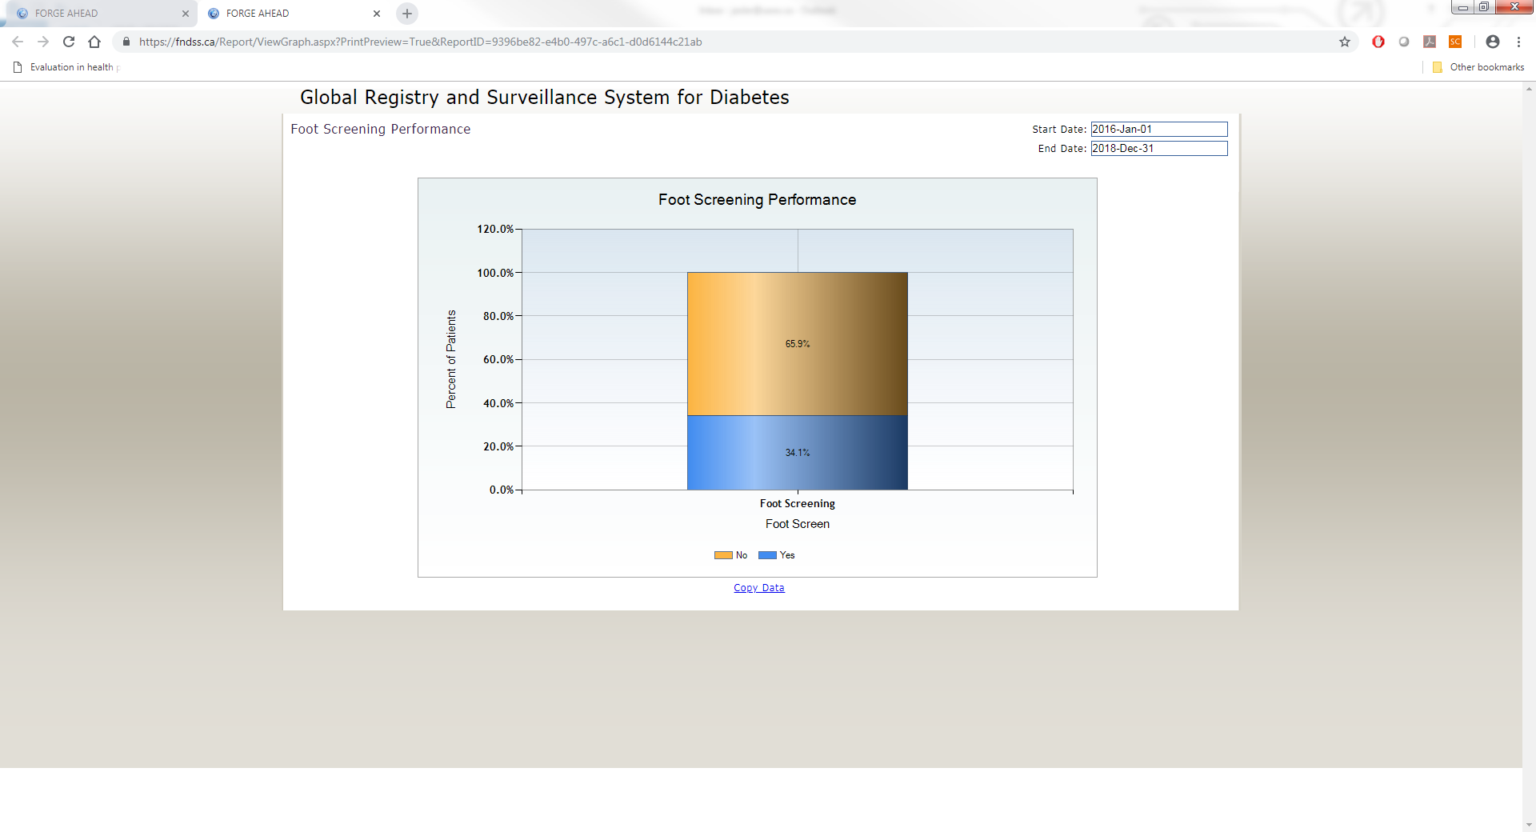
Evidence and Evaluation
Use of real data helps to drive improvements and secure resources
Notes:
Use evidence to show how this PDSA-proven program improves efficiency (time, money or both)
It helps to spread innovations if you can show that day-to-day work is made easier

Slide 17
Training
Training and documentation help to reduce program disruption if there is turnover among staff
Ensure continuity in institutional knowledge and team learning
Provide training to other staff how to use the PDSA cycle approach
Over time QI will be eventually become “a way of doing” and will require less training and staff time
Notes:
QI team members are now the knowledge keepers – have gone through many PDSA cycles – pass this knowledge to people coming up

Slide 18

Questions?

Slide 19
The Kahnawake School Diabetes Prevention Project (KSDPP)
Case Study

Slide 20

About the KSDPP
Located in Kahnawake Mohawk Territory, Quebec
Two areas of focus
  Community-based interventions
  School-based interventions
Based on
  Participatory research
  Knowledge translation
Has continued for ~ 25 years
Notes:
The Kahnawake School Diabetes Prevention Project (KSDPP) has two types of interventions; school interventions and community interventions. The school interventions work directly with the children in a school environment while the community interventions work within the community with the general population.

Slide 21
Factors Supporting Sustainability of the KDSPP
Community Advisory Board meets monthly and insists community activities continue
Dedicated project personnel Active Research Team meets monthly, seek projects of community interest
ADI funding continues to support community intervention
In-kind support from Mohawk Council of Kahnawake
Collaborations between various departments and people
Notes:
The community advisory board is used to engage the local community and foster leadership which is one of the factors of spread and sustainability.
The active research team is an example of the teamwork factor of spread and sustainability.
Funding and in-kind contributions are continuously given through the evaluation of the program and evidence that the program improves the health of the community.
Collaborations between various departments and people are seen through the collaboration between health professionals and school staff. The collaborations between organizations and between people are one of the factors of spread and sustainability.

Slide 22
Workshop Discussion
What will be the key factors in your community to ensure that quality improvement activities will be sustained or be spread to other areas?
Leadership
Teamwork / Engagement
Partnership and Collaboration
Evidence and Evaluation
Training
Notes:
Are there any other factors not listed here for example TIME FUNDING….

Slide 23
Workshop Discussion
PDSA-Proven Processes/Programs
  Which ones have worked for your team?
  Which ones do you want to sustain?
  What challenges do you see?
Collaboration
  With whom do you have existing collaborations?
    In your unit
    In your centre
    In your community
    External to your community
  With whom would a new collaboration be advantageous?
Notes:
Activities are similar to a PDSA cycle
Build in ongoing evaluation and successes
Showing the benefits of a change (cost savings, greater participation, happier staff, better compliance, etc.) to gain support from leadership, staff and community

Slide 24
Workshop Discussion
Strategies Using Factors for Sustainability & Spread
Leadership
  Obtain community leadership approval to spend time on QI
Teamwork / Engagement
  QI team members continue to meet
Partnership and Collaboration
  Identify and liaise with those involved in the health of community members
Evidence and Evaluation
  Plan chart audits and surveys to understand the current status of health in your community
Training
  Continued access to the REACH training modules and templates
Notes:
Here we have the known factors for successful sustainability/spread
Let’s brainstorm examples of strategies to use for each one

Slide 25
Sustainability
Worksheet

Slide 26
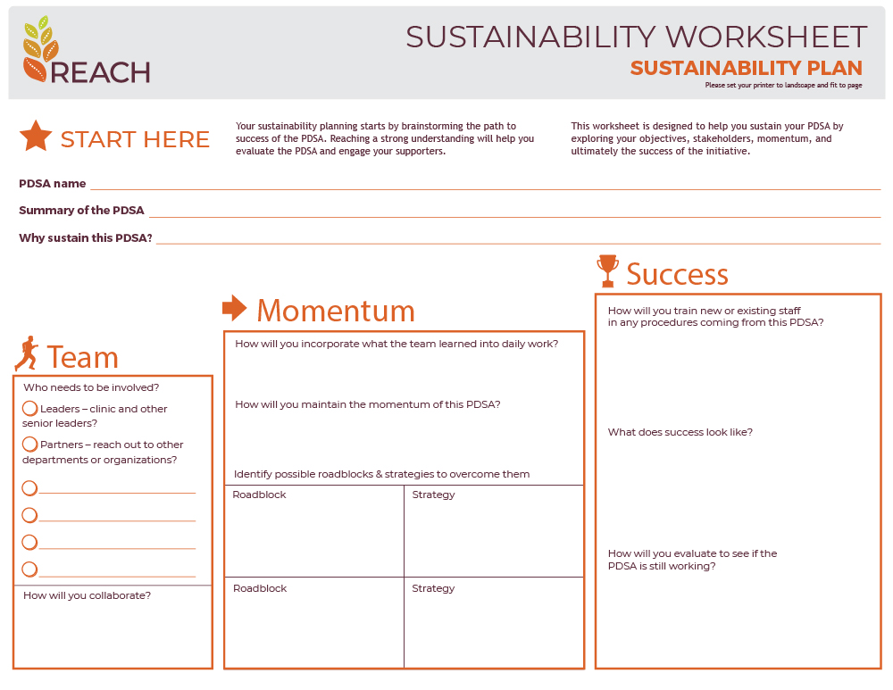
Sustainability Worksheet
Sustainability Plan
Your sustainability planning starts by brainstorming the path to success of the PDSA. Reaching a strong understanding will help you evaluate the PDSA and engage your supporters.
This worksheet is designed to help you sustain your PDSA by exploring your objectives, stakeholders, momentum, and ultimately the success of the initiative.

Slide 27
Sustainability Worksheet
PDSA Details
This section of the worksheet identifies the specific PDSA being used and provides a brief description of its purpose. This helps to ensure that everyone involved in the Sustainability Worksheet is on the same page and understands what is being worked on.

Slide 28
Sustainability Worksheet
Team
In this section of the worksheet, you will find a description of the individuals and stakeholders who are involved in the PDSA cycle, including leaders and partners. The expected contributions from each team member should also be tracked.

Slide 29
Sustainability Worksheet
Momentum
In this section, strategies are outlined for overcoming obstacles and keeping the project on track. For the PDSA cycle to sustain momentum, it is important to analyze lessons learned and problems encountered during the cycle.

Slide 30
Sustainability Worksheet
Success
Our goal in this section is to summarize the results of the sustainability initiatives and whether or not the goals have been achieved, and to emphasize the necessity of staff training and involvement for any long-term success.

Slide 31
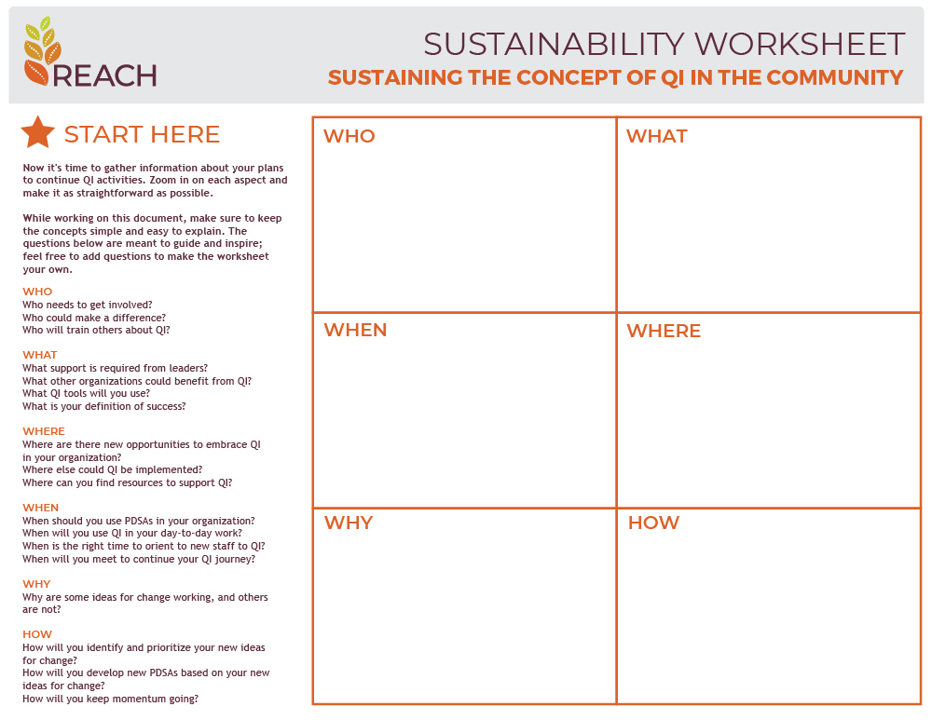
Sustainability Worksheet
Sustaining the concept of QI in the community
Now it's time to gather information about your plans to continue QI activities. Zoom in on each aspect and make it as straightforward as possible.
While working on this document, make sure to keep the concepts simple and easy to explain. The questions below are meant to guide and inspire; feel free to add questions to make the worksheet your own.

Slide 32
Sustainability Worksheet
Sustaining the concept of QI in the community
WHO
WHAT
Who needs to get involved?
Who could make a difference?
Who will train others about QI?
What support is required from leaders?
What other organizations could benefit from QI?
What QI tools will you use?
What is your definition of success?
WHERE
WHEN
Where are there new opportunities to embrace QI in your organization?
Where else could QI be implemented?
Where can you find resources to support QI?
When should you use PDSAs in your organization?
When will you use QI in your day-to-day work?
When is the right time to orient to new staff to QI?
When will you meet to continue your QI journey?
WHY
HOW
Why are some ideas for change working, and others are not?
How will you identify and prioritize your new ideas for change?
How will you develop new PDSAs based on your new ideas for change?
How will you keep momentum going?

Slide 33
[insert community photo]
Sustainability Planning
Working Session

Slide 34
Reminder to Complete the Workshop Evaluation Form

Slide 35
[insert community photo]
Elder Closing
[Name of Elder]

Slide 36
THANK YOU

