Slide 1
[CommunityLogo]
[Community Name]
Notes:
Hello and welcome here is what we’ll do today…
NEXT SLIDE

Slide 2
AGENDA
Time | Topic | Who
9:00 | Opening | Elder
9:15 | Welcome Introductions | Western
9:30 | REACH Overview | Western
9:45 | Team QI Session 1 Identify priority areas for improvement Develop ideas for change | QI Team
10:30 | BREAK | All
10:45 | PDSA Cycles | Western
11:00 | Team QI Session 2 PDSA planning Planning for Action Periods | QI Team
11:45 | Closing | Elder
Notes:
This is a 3 hour session – all times are approximate
[ELDER] will start the meeting
Then we’ll do introductions of the QI team
We will do a very brief overview of REACH
Then you will work together to launch the QI thinking specifically identifying areas to be improved and developing ideas
Then there’ll be a 10-15 min break
I’ll do a short review of the PDSAs then at the second Team QI Session you’ll have a chance to plan 1 or 2 PDSAs
Then [ELDER] will close

Slide 3
[insert community photo]
Elder Opening
[Name of Elder]

Slide 4
Introductions
Notes:
Some of us have met before but it has been awhile
It would be great if everyone introduces themselves and maybe shares/describes their favourite place in the community or a special event unique
We’ll start with [FACILIATATOR] ….

Slide 5
REACH Program Overview
Workshop Objective
Support community partners and teams develop community-designed initiatives to improve diabetes prevention and management in their community.
Notes:
The objective of this first Workshop is to help you, as you launch into the new process of quality improvement.

Slide 6
REACH Program Overview
Community Facilitator
Data
Keeper
QI Team
Notes:
The core of REACH is YOU the community QI team. The community leading the way ensures local knowledge, priorities and policies are respected [met, adhered to, reflected ]
[COMMUNITY FACILITATOR NAME], as the community facilitator, supports the QI team in several ways: SHE has already worked with us to prepare for the workshop, today and at future workshops SHE’LL facilitate the team QI sessions, and when you’re in the action periods SHE will facilitate the team meetings and liaise with JIM
[DATA KEEPER NAME], as the Data Keeper, will use [CEDAR / NAME EMR] to provide clinical data to the team to inform QI initiatives.
[QI TEAM MEMBER-1], [QI TEAM MEMBER-2], [QI TEAM MEMBER-3], [ETC], as QI team members, will plan and run the PDSAs, attend meetings, and honestly share their opinions and ideas

Slide 7
REACH Program Overview
Workshop 1
[date]
Action Period 1
Act: Delegate work
QI Coaching & Support
Workshop 2
[date]
Action Period 2
Workshop 3
[date]
QI Tools
Action Period 3
Sustainability Phase
Notes:
COMMENTS = change dates for each community; make diagram larger
REACH consists of three workshops when you will review QI methods and develop detailed plans together, each followed a QI Action Period when you will implement the plans and decide how to proceed.
As mentioned before, QI coaching and support will also be provided by JIM through regular communication with [COMMUNITY FACILITATOR] & [DATA KEEPER].

Slide 8
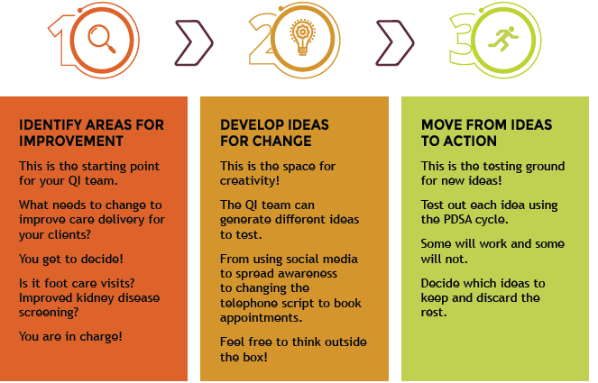
QI Process
Notes:
Using this QI approach can be seen as progressing through three linked phases.
In this process, teams begin by identifying areas for improvement by thinking about your health care system and available resources and looking at gaps in care processes or outcomes.
Through this initial phase the team will begin to develop goals and ideas for changes that can be made to improve diabetes care.
The team will then begin to discuss how to move these ideas into action and test out their ideas in practice.

Slide 9
Comments on the QI Process
“It changed our mindset, completely. But, at the end of the day, the PDSA tool that you gave us, the way we changed our minds when facing a problem, I mean, it’s priceless … it’s really amazing… We took the problems that we had and we broke it, like, as much as we could in small little pieces and we were able to do some changes… we’re using it every day with anything that happens.”
Notes:
During end-of-program interviews, QI team members from FORGE AHEAD had this to say about QI ……

Slide 10
Team QI Session 1 - Focus
Notes:
At your first session you’ll focus on the first two phases

Slide 11
Identifying Areas for Improvement
An area for improvement is a gap in care, a need or processes that need upgrading
How to identify areas for improvement for your community?
  Consult existing strategic/planning documents i.e. Community Health Plan
  Review the REACH IDCQ report – Focus Our Efforts section
  Reflect on status of clinical care
  Are there any other areas to improve?
Notes:
You can start with the IDCQ report – you were asked about 7 specific areas in the questionnaire plus asked if there were additional areas. The Focus Our Efforts section summarizes the responses.
You can also review the status of current clinical care from data presented or your own experience.
Plus you can go with your gut and propose a whole new area to focus on.
The trick is to document all ideas but pick one or 2 main areas to focus on for the workshop today
There is no right or wrong here – its up to you

Slide 12

Developing Ideas for Change
An idea for change is an action/effort that may improve the ways things are now
  does not have to be something completely new or extensive
  consider small changes to existing programs or services
Focus on using existing resources
Obtain ideas from those who work in the area
Use experience of others who have successfully made improvements.
Notes:
Now that you have chosen one or two Areas to Improve - the fun part starts – thinking of specific ideas that would improve things in that Area.
An idea for change is an action/effort that may improve the ways things are now
specific ideas can come from people’s insights into their work, creative thinking ‘outside the box’, and borrowing from the experience of others.
You can easily improve things with a $million but since this is reality think of ideas that would cost very little

Slide 13
Areas for Improvement & Ideas for Change
Areas for Improvement | Ideas for Change
Increase foot exams for people who have appointments | Flagging a chart
 | Removing shoes and socks
 | Reminder poster on the wall for staff
Increase foot exams for people with diabetes | Advertise to come to clinic on “foot exam day”
 | Do home visits for foot exam
 | Mobile clinic – go to elder socials

Slide 14
Team QI Sessions - What to Expect
[Facilitator] will lead the discussion
Will need note-taking and time-keeping roles
Important to have input from all team members
Support from REACH program staff
Notes:
[Facilitator] will lead the discussion
Will need note-taking and time-keeping roles
Important to have input from all team members
Support from REACH program staff

Slide 15
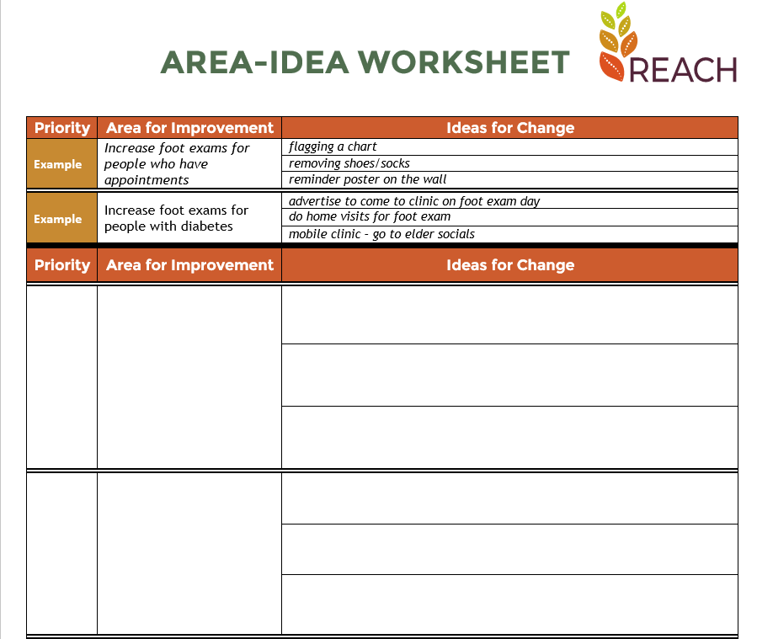
Team QI Session 1
Brainstorm and generate a list of areas of improvement
Prioritize 1-2 areas to focus on to develop ideas for change
Complete the AREA-IDEA WORKSHEET
Notes:
The session will be about an hour - here is your agenda.
We suggest spending 30 minutes generating a list of areas of improvement
The remaining 30 minutes prioritize 1-2 areas to focus on and brainstorm ideas for change

Slide 16
[insert community photo]
Team QI Session 1

Slide 17
Team QI Session 1
30 minutes generating a list of areas of improvement
30 minutes prioritize 1-2 areas to focus on and brainstorm ideas for change
Complete the AREA-IDEA WORKSHEET

Slide 18
[insert community photo]
BREAK
Notes:
Its time for our 10-15 minute break we’ll start again at XXXXX

Slide 19
Team QI Session 2 - Focus
Notes:
You’ve just completed steps 1 and 2 now we’ll MOVE FROM IDEAS TO ACTION

Slide 20
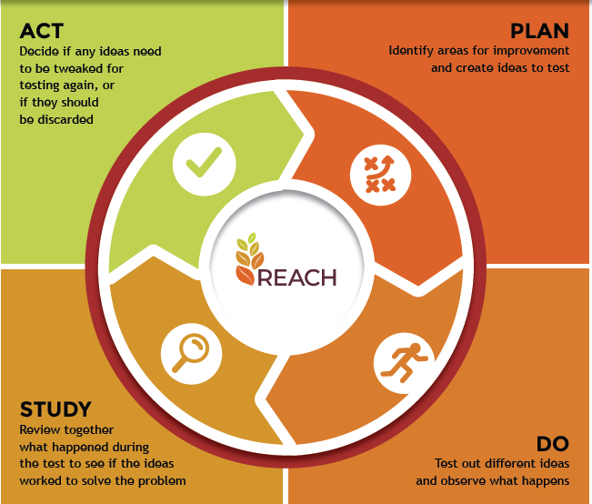
Move from Ideas to Action
How will the team know which idea will work and be successful?
Test using PDSAs!
Notes:
How will you know which idea or strategy will be successful? You have to test them
Testing helps the team learn more about how the idea will work in the “real world” before going ahead and spending time and maybe money

Slide 21
The PDSA Cycle
Notes:
The PDSA Cycle
P – PLAN – plan the testing of your idea
D – DO – do the test including observing and measuring
S – STUDY – review what happened; decide whether the idea solved the problem completely or partially
A – ACT - decide to stop or continue with testing

Slide 22
The PDSA Cycle
  Testing ideas quickly and on a small number of people
    Allows for momentum and increasing belief it will result in improvement
    Builds confidence change will result in improvement
    Acting on learning before fully implementing in practice
Notes:
The PDSA method is great because you do tiny experiments and learn more about the idea that you’re testing as you go.
When we say small scale – we mean 1 or 2 staff members or 1-5 patients

Slide 23




Example PDSA
PLAN
Objective questions and predictions (why) plan to carry out the cycle (who, what, when, where)
Develop a Diabetes Welcome Kit
Amy to develop first draft of the kit
Sarah to test the draft with healthcare professionals and patients
DO
Carry out the plan, document problems and unexpected observations, begin data analysis
Amy develops the first draft
Sarah tests the first draft with 5 patients
STUDY
Complete the analysis of the data, compare data to predictions, summarize what was learned
Patients provide recommendations to make the content more culturally appropriate
ACT
What changes are to be made? Next cycle?
Amy develops a new draft
QI team decides to test this new draft with another PDSA cycle
Notes:
Lets review a couple of real examples
READ SLIDE

Slide 24
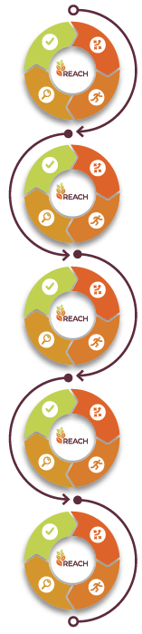
PDSA cycles can build towards solutions
Monofilament placed on exam table to prompt provider. Test with 5 patients on one day. No exams done. Provider ran out of time.
CYCLE 1
Post sign to prompt patients to remove shoes and socks. Test with 5 patients next day. Most patients did not understand.
CYCLE 2
RPN rooming patient removes shoes and socks. Test with 5 patients next day. 4 of 5 feet examined. RPN forgot to remove shoes with one patient.
CYCLE 3
Put foot care stamp in EMR or flag paper chart to prompt RPN. All patients received foot exam.
CYCLE 4
CYCLE 5
Implement process for all patients as a clinic protocol.
Notes:
Repeating the PDSA cycle with modest changes can result in improvement

Slide 25
Comments on PDSAs
“I think the PDSAs for - our team kind of started to kind of joke about them, so everything we do now, we say, oh, that’s a PDSA, so any kind of little thing that might be a change, or that might kind of result in a different outcome. Oh, we should do a PDSA for this… we’re definitely always thinking of how we can improve, whether it’s our attendance to programs, or the way that we’re delivering things, or the way that we’re communicating, things like that.”
Notes:
Some more Feedback from FORGE AHEAD participants

Slide 26
Team QI Session 2
Develop PDSAs
  Choose one idea from your list of ideas for change
  Develop a detailed plan to try your idea – the P of the PDSA
Prepare for Action Period
  Discuss how you will continue to meet as a team – huddles, email updates, team meetings
  Decide how often you will need to meet to support the PDSA process
  Assign roles - organizing, note taking, capturing progress, etc.
  Set up the next date & time you will meet

Slide 27
Planning is Key!
“To achieve great things, two things are needed; a plan, and not quite enough time.” – Leonard Bernstein
“A good plan today is better than a perfect plan tomorrow” – George S. Patton
Notes:
Here are some quotes acknowledging the importance of planning
“To achieve great things, two things are needed; a plan, and not quite enough time.” – Leonard Bernstein – American composer he did West Side Story
“A good plan today is better than a perfect plan tomorrow” – George S. Patton – American general in WWII
The act of preparation and planning is not new - are there any “sayings’ or expressions in your community about the importance of planning?

Slide 28
Team QI Session 2
What is the idea you are going to test?
Who will run the test?
What preparation is required
Where will it take place?
When will it take place?
How are you going to measure and record your success?
When will the team get together to study the findings of the test?
PLAN
Objective questions and predictions (why) plan to carry out the cycle (who, what, when, where)
PLAN
Objective questions and predictions (why) plan to carry out the cycle (who, what, when, where)
PLAN
Objective questions and predictions (why) plan to carry out the cycle (who, what, when, where)
PLAN
Objective questions and predictions (why) plan to carry out the cycle (who, what, when, where)
Notes:
Answering each of these questions develops your plan for each idea
What is the idea you are going to test?
Who will run the test?
What preparation is required
Where will it take place?
When will it take place?
How are you going to measure and record your success?
When will the team get together to study the findings of the test?
The PDSA cycle workbook may be helpful to document your plan and keep track of your notes and results during the DO your discussion in the STUDY and your decisions in the ACT phases
It is also a way to provide information Jim so he provide support.

Slide 29
[insert community photo]
Team QI Session 2

Slide 30
Team QI Session 2
What is the idea you are going to test?
Who will run the test?
What preparation is required
Where will it take place?
When will it take place?
How are you going to measure and record your success?
When will the team get together to study the findings of the test?
50 minutes planning 1-2 PDSAs
10 minutes preparing for Action Period
  How you will continue to meet as a team
  How often you will need to meet to support the PDSA process
  Assign roles
  Set up the next date & time

Slide 31
Next Steps
Your first QI Action Period starts tomorrow!
Be sure to capture your plans, progress & success
Remember you have support from the REACH Program Team
Workshop #2 to be scheduled in [month]
Notes:
READ SLIDE
WE WILL BE SENDING YOU A VERY BRIEF ANONYMOUS WORKHSHOP EVALUATION SURVEY TO OBTAIN YOUR FEEDBACK

Slide 32
[insert community photo]
Elder Closing
[Name of Elder]

