Slide 1
[CommunityLogo]
[Community Name]
Notes:
Hello and welcome here is what we’ll do today…
NEXT SLIDE

Slide 2
REACH Program Overview
Workshop Objective
Facilitate sharing of QI experiences by earlier community facilitators
Support community partners and teams develop community-designed initiatives to improve diabetes prevention and management in their community.
Notes:
The objective of this first Workshop is to help you, as you launch into the new process of quality improvement.

Slide 3
AGENDA
Time | Topic | Who
9:00 | Opening | Elder
9:15 | Welcome / Introductions | Western
9:30 | FORGE AHEAD QI Experience | Knowledge-sharer
10:15 | Status of PDSAs | Western and QI Team
10:30 | BREAK | All
10:45 | Team QI Session | QI Team
11:45 | Closing | Elder
Notes:
To This is a 3 hour session – all times are approximate
[ELDER] will start the meeting
Then we’ll do introductions of the QI team
We will do a very brief overview of REACH
Then you will work together to launch the QI thinking specifically identifying areas to be improved and developing ideas
Then there’ll be a 10-15 min break
I’ll do a short review of the PDSAs then at the second Team QI Session you’ll have a chance to plan 1 or 2 PDSAs
Then [ELDER] will close

Slide 4
[insert community photo]
Elder Opening
[Name of Elder]

Slide 5
[QI Team Photo]
Introductions
Notes:
Some of us have met before but it has been awhile
It would be great if everyone introduces themselves and maybe shares/describes their favourite place in the community or a special event unique to your community
We’ll start with Carlene ….

Slide 6
Sharing My QI Experience
[Knowledge-Sharer]
Notes:
Some of us have met before but it has been awhile
It would be great if everyone introduces themselves and maybe shares/describes their favourite place in the community or a special event unique
We’ll start with [FACILIATATOR] ….

Slide 7
Status of PDSAs

Slide 8
[insert community photo]
BREAK
Notes:
Its time for our 10-15 minute break we’ll start again at XXXXX

Slide 9
[insert community photo]
Team QI Session

Slide 10
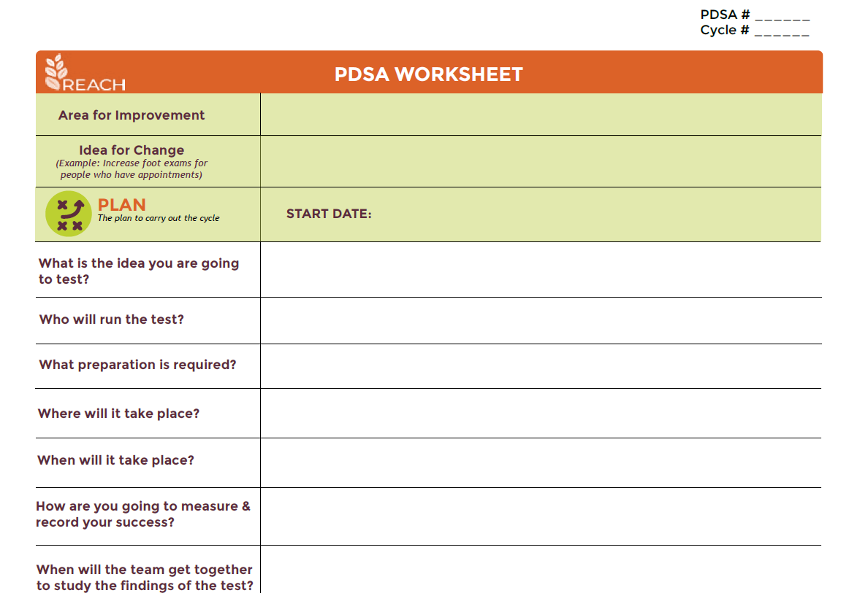
Team QI Session 2
Notes:
The PDSA cycle worksheet may be helpful to document your plan and keep track of your notes and results during the DO your discussion in the STUDY and your decisions in the ACT phases
It is also a way to provide information Jim so he provide support.

Slide 11
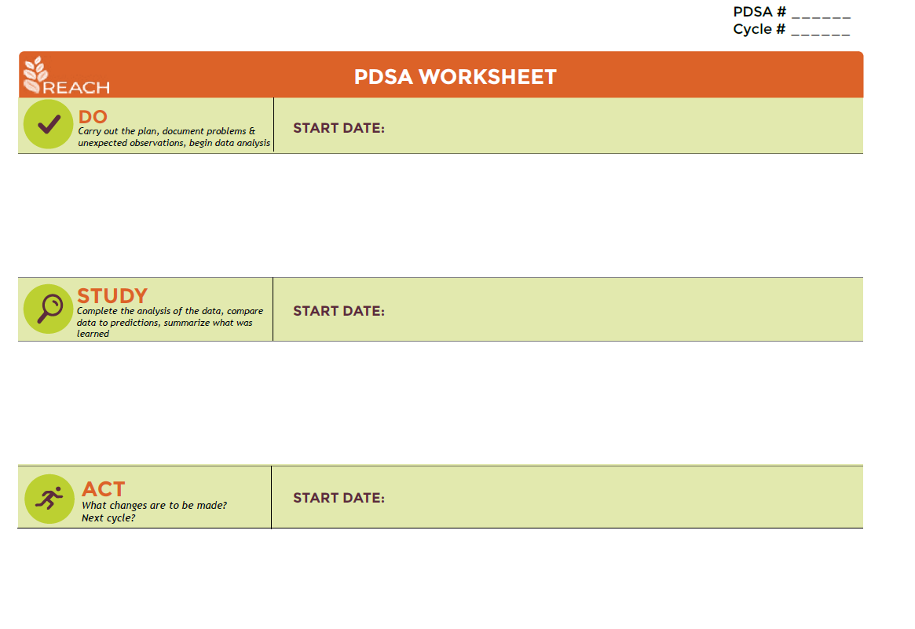
Team QI Session 2
Notes:
The PDSA cycle worksheet may be helpful to document your plan and keep track of your notes and results during the DO your discussion in the STUDY and your decisions in the ACT phases
It is also a way to provide information Jim so he provide support.

Slide 12
Next Steps
Prepare for Action Period
  Discuss how you will continue to meet as a team – huddles, email updates, team meetings
  Decide how often you will need to meet to support the PDSA process
  Assign roles - organizing, note taking, capturing progress, etc.
  Set up the next date & time you will meet

Slide 13
Next Steps
Your second QI Action Period starts tomorrow!
Be sure to capture your plans, progress & success
Remember you have support from the REACH Program Team
Workshop #3 to be scheduled in [month]
Notes:
READ SLIDE
WE WILL BE SENDING YOU A VERY BRIEF ANONYMOUS WORKHSHOP EVALUATION SURVEY TO OBTAIN YOUR FEEDBACK

Slide 14
[insert community photo]
Elder Closing
[Name of Elder]

