Slide 1
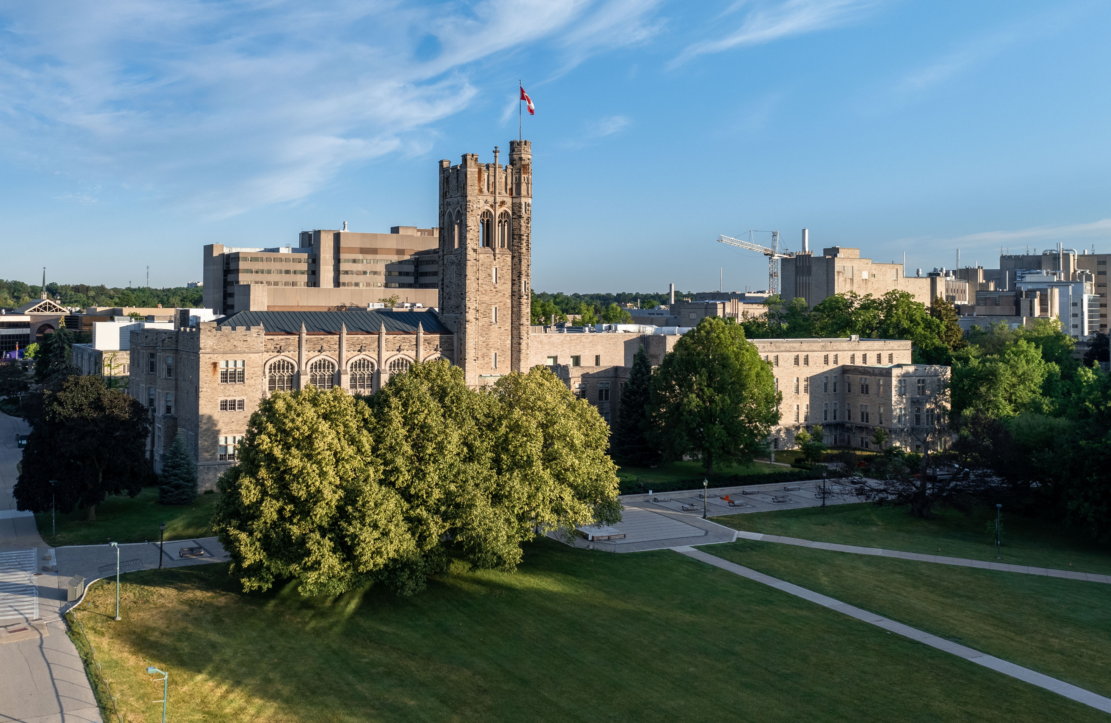

Office of the Registrar
  Undergraduate Recruitment
  Admissions
  Student Central
  Exams
  Student Financial Services
  Student Records
  Registrar Information & Technology Solutions
  Administration

Slide 2
Office of the Registrar Overview
AUGUST 2024
1
2
3
4
Introduction
Before a student comes to Western
When you’re a Western student
What does a Registrar do?
Recruitment and Admissions processes
overview of the year cycle

Slide 3


Slide 4
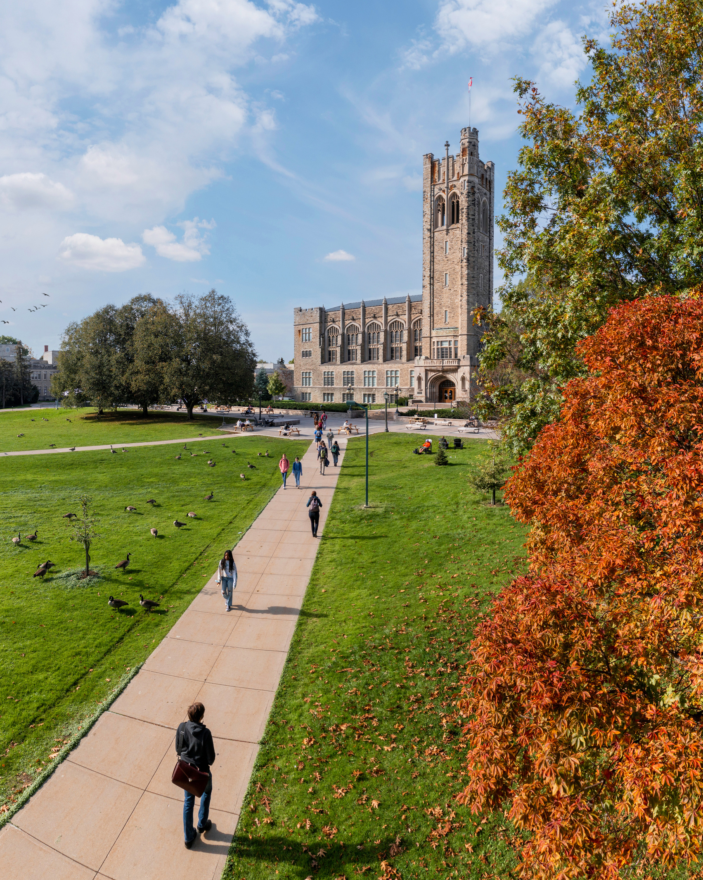
1
Introduction
Registrar
Marisa Modeski
  Undergraduate Recruitment
  Admissions
  Student Central
  Exams
  Student Records
  Student Financial Services
  Registrar Information & Technology Solutions
  Administration
270+
Full-time, part-time and student staff employed in the OOR

Slide 5


Recruitment
Admissions
What those teams do:
Exams
Enrolment
Systems
Course
Enrolment
Financial Aid, Scholarships and Awards
Student
Records

Slide 6

2
Before a student comes to Western
Recruitment and Admissions processes

Slide 7
sept
oct
nov
dec
jan
feb
mar
apr
may
jun
jul
aug
DISCOVER
APPLY
ACCEPT
REGISTER
Learning and ranking schools, based on their top decision factors.
  how do I get the career I want?
  what is Western like?
  how do I know if the school is the right fit?
  is this program better at Western than another school?
Notes:
  international recruitment starts in the summer months
Understanding the admissions process.
  what do I need to apply?
  can I get in? costs and grades.
  how long do I have to wait to get an offer?
Notes:
  Ontario Highschool student deadline for applications is mid-January
  All other applicant deadline is March 1, however, all programs remain open until they are closed/filled on OUAC
Comparing institutions and programs. Asking for advice and information. Making a final decision.
  how do I choose?
  what are my next steps?
  why did others pick Western?
  will I belong?
  what experiences will I have?
Notes:
  Ontario Highschool student deadline for acceptance is early June
  Other students will have a deadline of May 1, but some will have rolling deadlines, based on when they applied.
Seeking clarity on what needs to be done, and in what order. Getting excited.
  meeting admission requirements
  summer academic orientation
  course registration
  tuition and financial aid
  residence and moving to London
  Orientation
Opening September 2024: new Campus Tour Centre, located by Student Central (WSSB 1120)
CAMPUS TOURS
begin on September 16, with full campus tours (in residences) on October 4.
ONTARIO UNIVERSITIES FAIR: Oct 5 & 6, 2024
FALL PREVIEW DAY: Sunday, November 17, 2024
SPRING OPEN HOUSE: Saturday, March 22, 2025

Slide 8

3
When you’re a Western student

Slide 9
Recruitment
Admissions
Exams
Enrolment
Systems
Course
Enrolment
Financial Aid, Scholarships and Awards
Student
Records

Slide 10
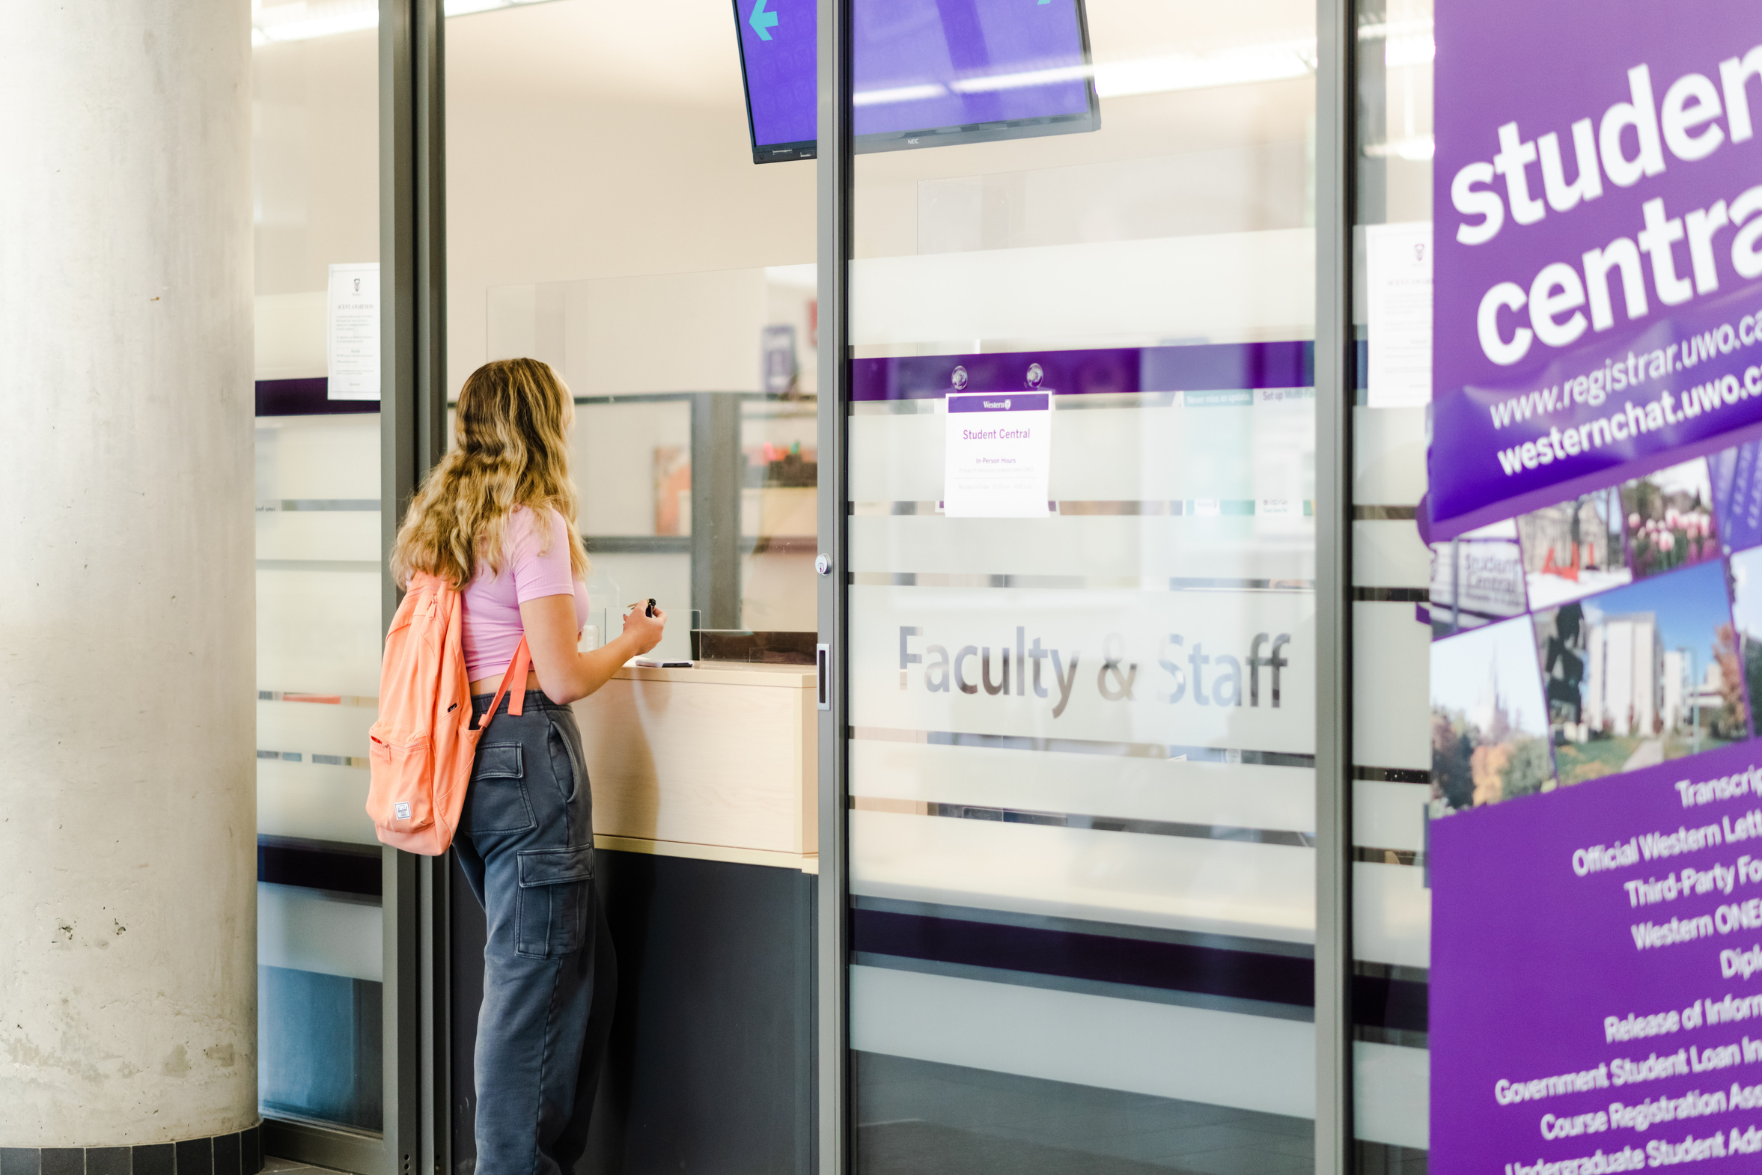
Student Central
Point of contact for students both online and in person.
  Course Descriptions
  Course Enrolment Support
  Transcripts
  Official Western Letters
  Third Party Forms
  Degree/Diplomas
  Student and Faculty Western ONECards
  Release of Information
  Updating Personal Information
112,026
Salesforce emails
57,399
Conversations on westernchat.uwo.ca
September 2023 to August 2024

Slide 11

2,000+
Student Financial Services
work study opportunities
Assisting students to finance their education.
  OSAP & Government Loans
  Fees & Refunds
  Scholarships & Awards
  Bursaries & Work Study
  Financial Counselling
  Tax Receipts
  US Student Funding
  First Generation Students
  Youth in Extended Society Care
  New to Canada Grant
ENTIRE
TUITION
COST
Up to the cost of a students’ tuition may be covered by bursaries
$45M
Administers over $45 million in scholarships, awards, bursaries and work study

Slide 12

29,818
Exams & Student Records
accommodated assessments during the academic year
  Academic Calendar
  Timetables
  Register in Courses
  Examinations
  Distance Studies
  Letter of Permission
  Visiting Undergraduate Students
  Academic Considerations
  Grades, Progression and Graduation
  Convocation
49,497
Proctortrack assessments
Sept 2023-April 2024
6,117
students registered with accommodations

Slide 13

Registrar Information & Technology Solutions
22,580
  Peoplesoft (student.uwo.ca)
  Salesforce
  Student Questionnaires on Courses and Teaching
  Choose.uwo.ca (offer holders portal)
  ...And powering other processes in our students’ day-to-day lives, such as Draft My Schedule, Timetables, etc.
Tickets booked for Spring Convocation
800+
Staff and Faculty setup / security tickets

Slide 14


Convocation
Recruitment
Admissions
Exams
Enrolment
Systems
Course
Enrolment
Financial Aid, Scholarships and Awards
Student
Records

Slide 15
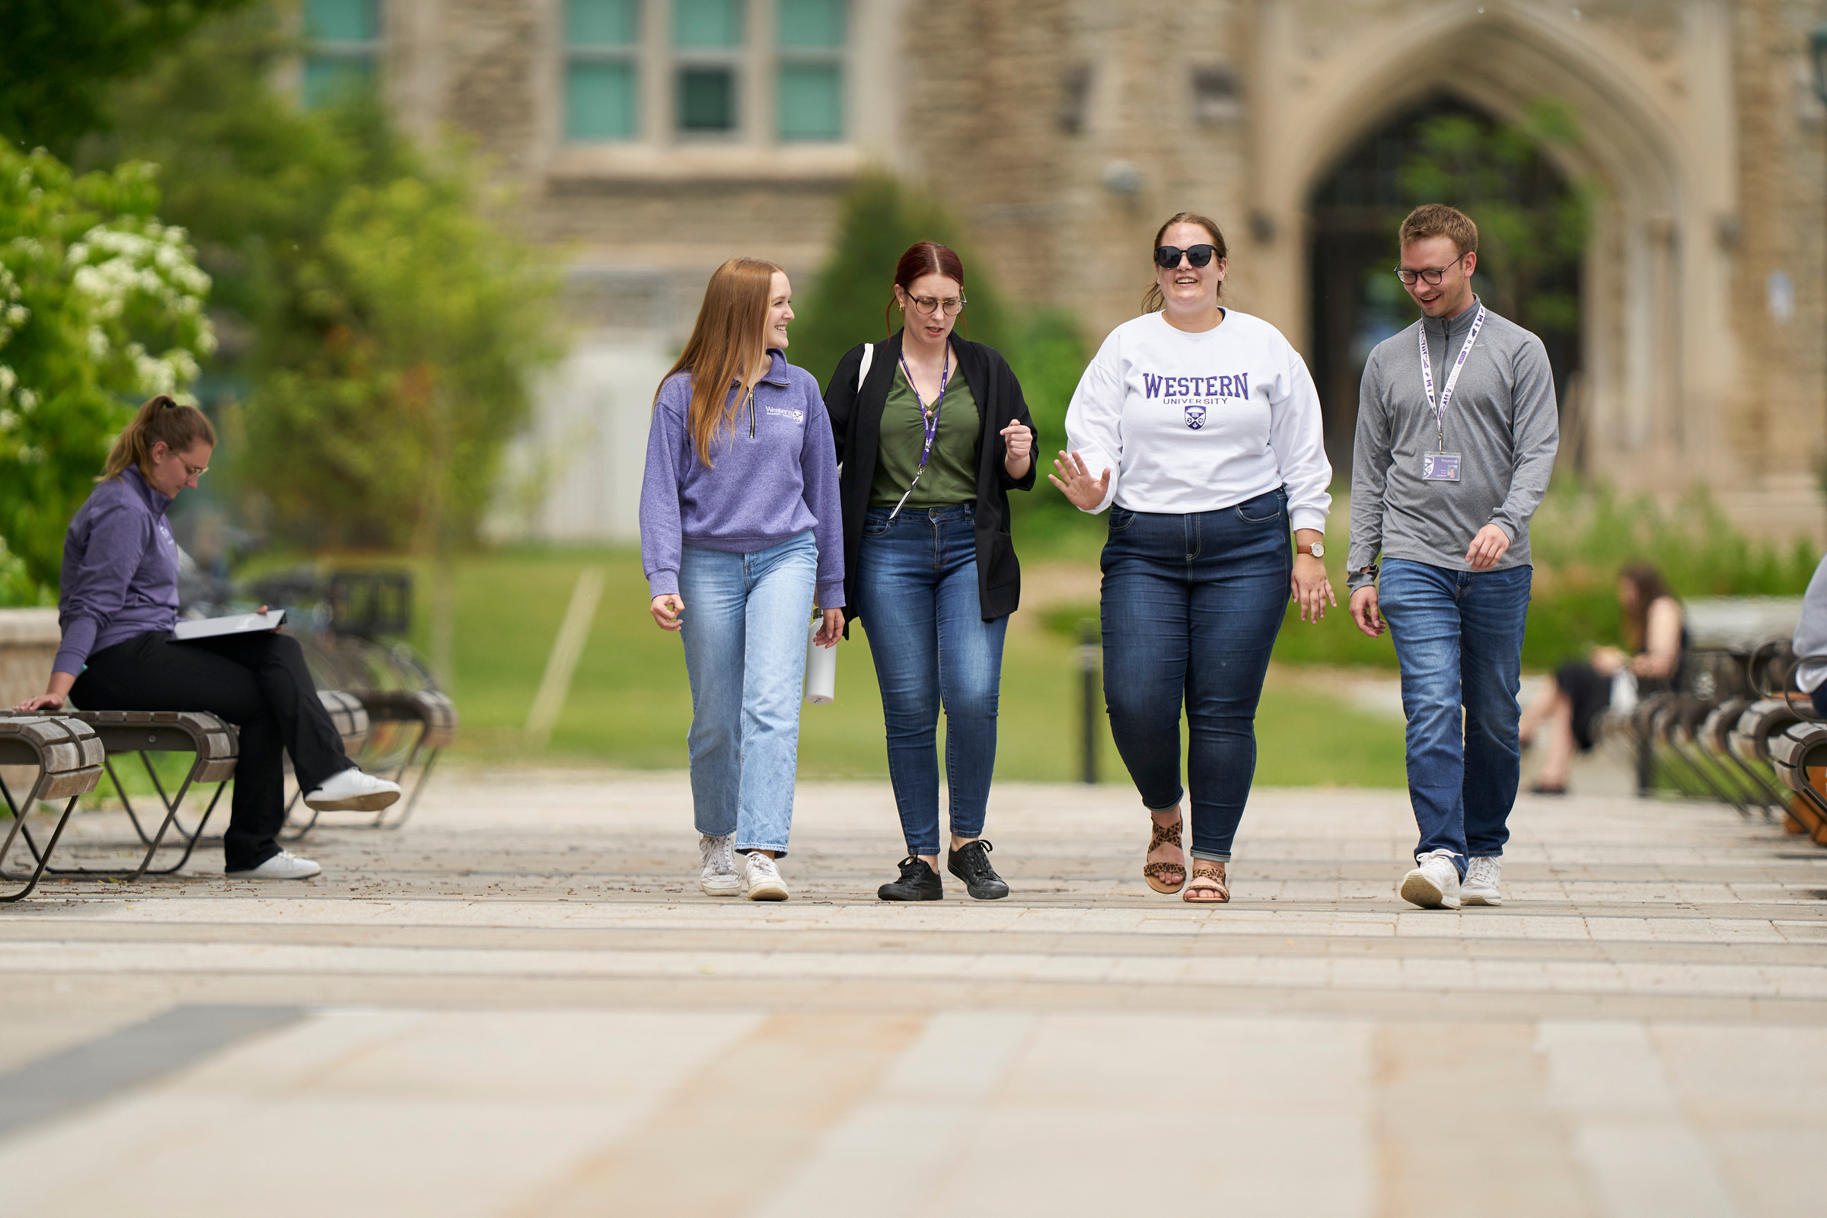
Conclusion

Slide 16
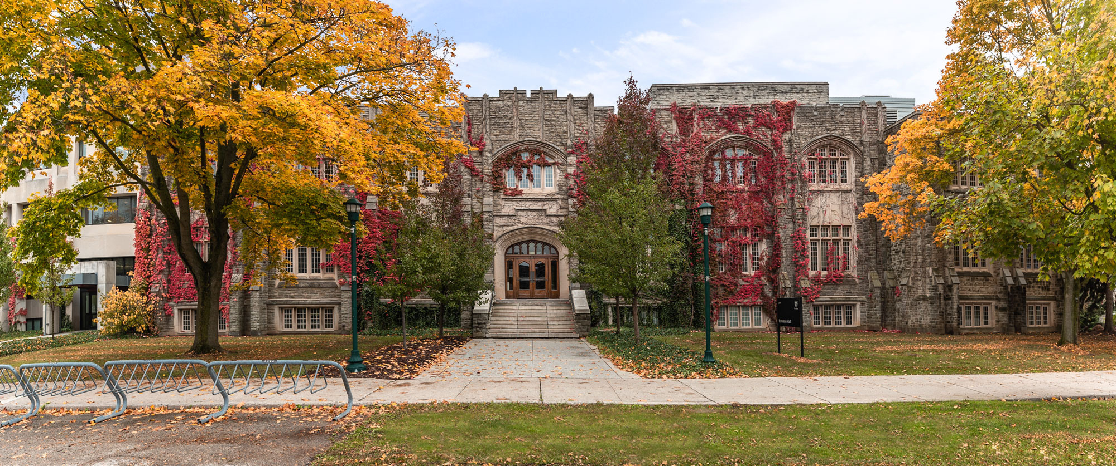
Thank you!
Marisa Modeski, Registrar
marisa.modeski@uwo.ca

