Slide 1
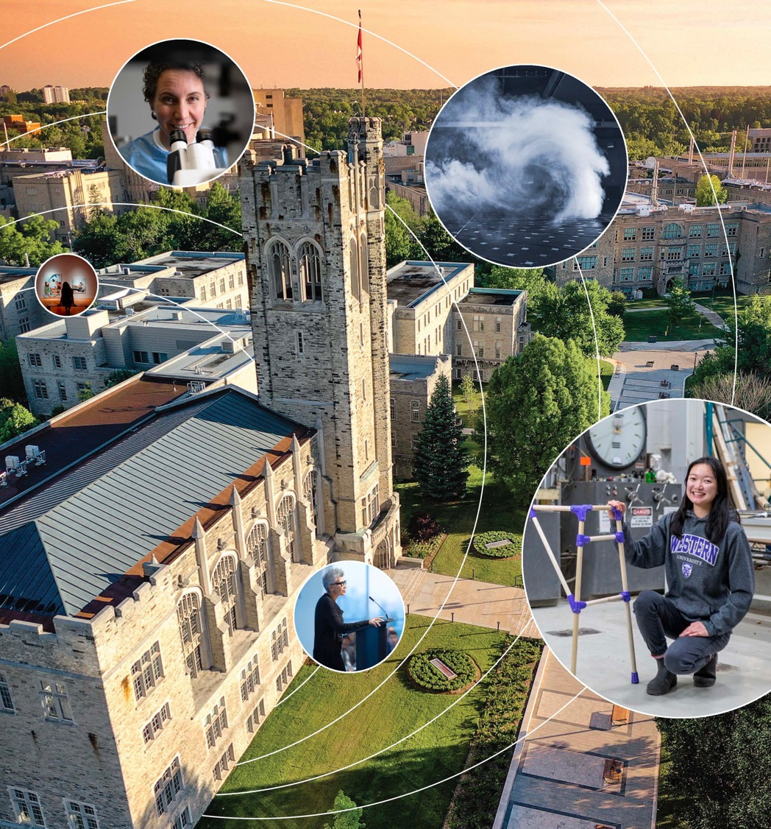
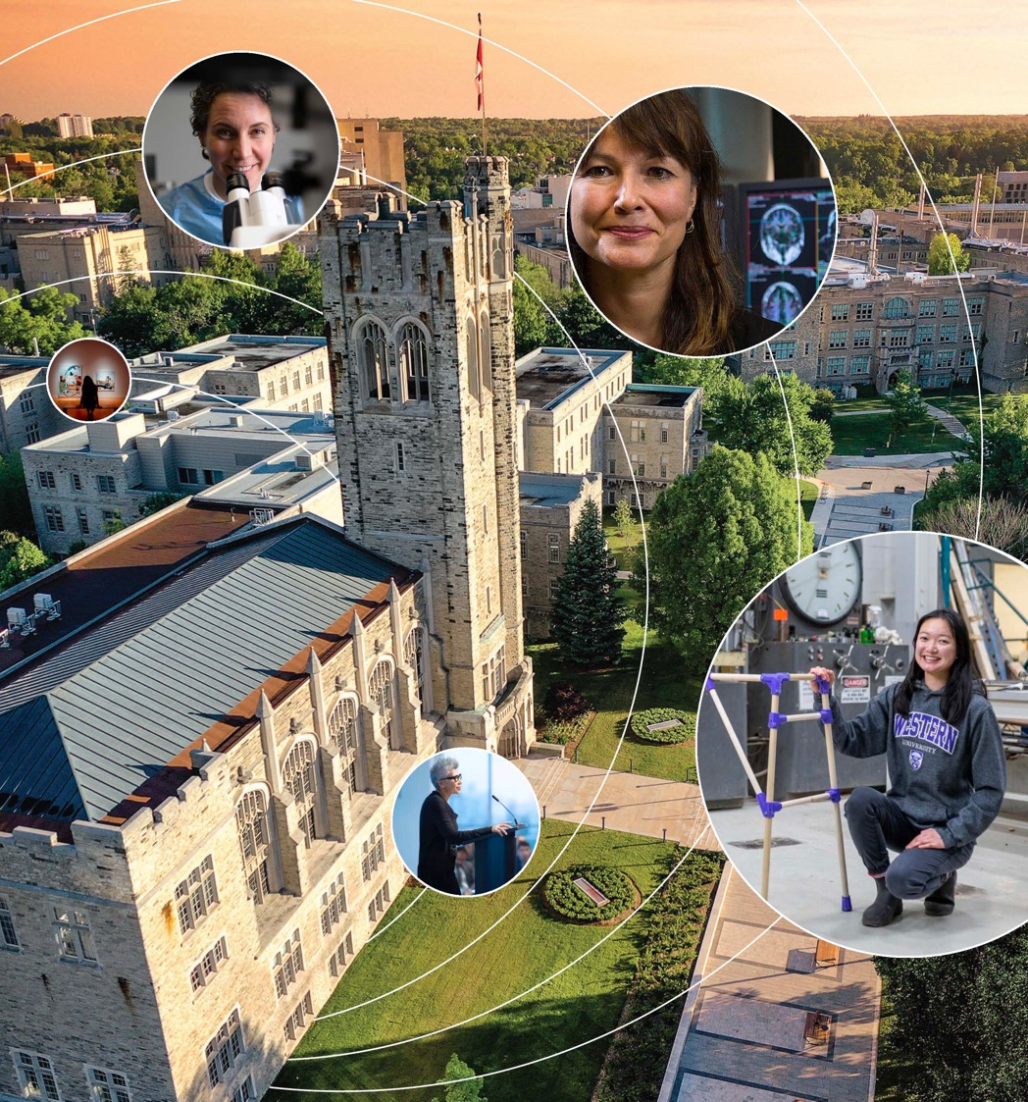

Research, Scholarship
& Creative Activity
at Western
Jacquie Burkell
Associate Vice-President (Research)
August 15, 2024
Notes:
A warm welcome to Western!
As Penny mentioned, we really look forward to working with you and to supporting your programs of research, scholarship or creative activity.
Our success is a collective responsibility.
We’re here to help ensure your work has impact – in whatever shape or form that takes for you.
I’m confident you will find most any kind of support you need somewhere on campus, so I highly recommend that, as you get settled, you reach out to your colleagues and to us in Western Research.
These relationships will help save you time and frustration, and set you on a path to success.

Slide 2
We’re in this Together
Notes:
Your research success is good for you, good for your students, and good for our institution – we all benefit.
What you can do for us
You are part of the team and are here because you are valued member already at Western
Your research contributes to the value of the institution, and to the institutional reputation
Research dollars are important to the institution, with implications for our research opportunities (e.g., CRCs) and our research funding
Research funding supports students
Research success enhances our reputation.
What you can do for yourself
Be kind to yourself
Make time for research
Connect with your colleagues
Look for mentorship opportunities

Slide 3

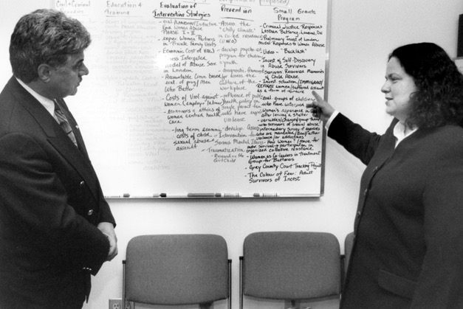
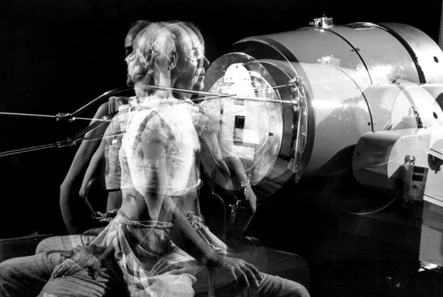
A History of Impact
Birthplace of Wind Engineering
The world-first Boundary Layer Wind Tunnel Laboratory has been used to test many of the world’s most significant structures
Leadership in Violence Prevention
The Centre for Research & Education on Violence Against Women & Children leads groundbreaking policy & legislative changes
World’s First ‘Cobalt Bomb’
Developed by London doctors in the 1950s,
the ‘cobalt bomb’ increased the cervical
cancer cure rate to 75% from 25%
Notes:
We should remind colleagues that we’re contributing to a long legacy of achievements at Western that continues today.
Research in London has hit above its weight for a very long time.
As a few examples:
(L) Did you know Western is considered the birthplace of the modern practice of wind engineering?
The first-of-its-kind Boundary Layer Wind Tunnel Laboratory has been used to test many of the world’s most significant structures, including the CN Tower, World Trade Center and Confederation Bridge.
We’re now home to four wind research facilities and are taking national leadership with the Northern Tornadoes Project and work at the WindEEE Dome, which was declared a national facility last year.
(C) For 30 years, the Centre for Research & Education on Violence Against Women & Children has continued to lead many groundbreaking policy and legislative changes related to domestic violence, child protection, child custody and labour employment standards.
A new project launched late last year with members of the department of economics is generating evidence to show the hidden financial costs of intimate partner violence to workplaces.
(R) And in the 1950s, London doctors developed the world’s first ‘cobalt bomb,’ increasing the cervical cancer cure rate to 75% from 25%.
London continues to home to an extremely strong cancer research community, including in diagnosis, imaging and drug development.
While not on the slide, creative activities on campus have also benefited tremendously from hosting Canada’s longest-running writer-in-residence program, which has, since 1972, welcomed writers like Margaret Laurence, Emma Donoghue and, most recently, Canadian writer and poet Téa Mutonji (tay-ah moo-tone-gee).
Across disciplines, our community continues to have major impact within the academy and for our communities, civil society and for industry.
ADDITIONAL CONTRIBUTIONS (Just background.)
Discovery of the sex chromatin (the “Barr Body,” discovered by Murray Barr), launching the field of genetics.
Landmark study showing Aspirin can prevent strokes and heart disease.
Discovery of Vinblastine, the first of a series of chemotherapy drugs – still used today.
During the 1950s, Tony Brown provided the genetic basis of insect resistance to insecticides.

Slide 4




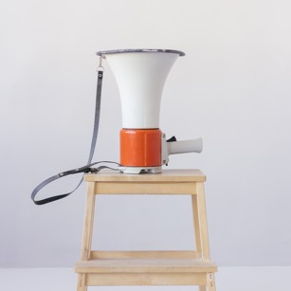

Role of Western Research
Accelerate & Support Success & Impact
Introduce Mechanisms to Support Collaboration
Proactively Remove Barriers to Participation
Meaningfully Connect Work to Regional & Global Communities
Promote Research, Scholarship & Creative Activity
Recognize & Celebrate Successes
Notes:
At a high level, the role of the office of the Vice-President (Research) is to:
Accelerate and support success and impact, while nurturing and strengthening a respectful culture of research, scholarship, creative activity and innovation.
Identify and introduce mechanisms to support collaboration and to advance interdisciplinary scholarship that tackles bigger research questions.
Proactively implement mechanisms for removing barriers to participation and to foster an inclusive research culture.
Ensure we take time to recognize and celebrate all of our wins – big and small, across all disciplines.
Promote a globally minded approach to curiosity, discovery, creativity and innovation.
And to meaningfully connect the work we do to those who can most benefit from it – right here in London, across Canada and around the world.
Our dedicated, professional team of approximately 160 staff members is a key partner in our research community’s success.
Collectively, we are committed to identifying and implementing tools, services and programs that help them to be competitive, to be successful and to have impact.
We also work very collaboratively with partners across campus – including faculty research officers, Associate Deans (Research), Research Finance, Procurement Services, etc. – to remove as much of the administrative load as possible and to help you focus more time on work you’re passionate about.
All of this to say: you don’t have to go at most of this alone – just reach out!
Collectively, we are committed to continuing to identify and implement tools, services and programs that help you have the support you need to remain competitive and be successful.
We also hold responsibility for advancing the university’s strategic plans.

Slide 5




Strategic Planning
Towards Western at 150
Greater impact
People, community & culture
Western’s place in the world
Mobilize for Impact!
Enhance research support
Foster relationships
Connect work to world
Tackle grand challenges
Indigenous Strategic Plan
Strengthen & build relationships
Nurture an inclusive campus
Research & scholarship excellence
Indigenize practices & spaces
Western in the World
Expand Global Range
Champion Global Citizenship
Amplify Research Impact
Enable Capacity for Global Success
Notes:
While we consult and connect directly to various strategic plans across campus – including those from individual faculties – Western’s plan, our Western Research plan, the Indigenous Strategic Plan and the new Global Engagement Plan are four primary touchpoints. (We will soon have one from the office of EDI, too.)
You’ll note there are close links and overlapping themes between the three plans – this is intentional.
I really encourage you to give them a read at your leisure to help understand the university’s high-level directions and guiding principles.
(1) Western’s research, scholarship and creative activity touch on all three goals found in Towards Western at 150, which include:
Greater Impact
People, Community & Culture
Western’s Place in the World
(3) The Indigenous Strategic Plan contains several goals I haven’t included on the slide, but these four are the most relevant to our daily work: (others included below for context; those on the slide are in bold).
Strengthen and build relationships with Indigenous Communities
Nurture an inclusive campus culture that values Indigenous peoples, perspectives, and ways of knowing
Enhance Indigenous students’ experience at Western
Achieve Excellence in Indigenous Research & Scholarship
Excel in Indigenous Teaching & Learning
Indigenize Western’s Institutional Practices and Spaces
Become a university of choice for Indigenous students
Increase Indigenous representation in staff and Faculty complement
(4) Our new Global Engagement Plan, Western in the World seeks to:
Expand Global Range
Champion Global Citizenship
Amplify Western's Global Research Impact
Enable Western's Capacity for Global Success

Slide 6
Mobilize for Impact!
PRINCIPLES
Catalyze Research, Scholarship & Creative Activity
Advance Equity, Diversity, Inclusion & Decolonialization
Engage With Partners
Balance Risks & Opportunities
OBJECTIVES
IMPACT
Enhance Research Support
Foster Relationships
Connect our Work to the World
Tackle the Grand Challenges of our Time
Notes:
While research advances each of the the three hemes found in Towards Western at 150, our plan is situated largely within Greater Impact -- specifically sections related to tackling grand challenges, enhancing connections and increasing impact.
Supporting our community to have greater impact is our north star.
Mobilize for Impact! includes four guiding principles:
Catalyze Research, Scholarship, & Creative Activity: We are committed to providing services and to fostering a culture of inclusivity that embraces, supports and accelerates research, scholarship, and creative activity in all disciplines and at all career and learning stages.
Advance Equity, Diversity, Inclusion, & Decolonialization: We are committed to taking proactive steps to improve equity, diversity, inclusion and decolonization by ensuring ethical engagement with regional Indigenous communities and by advancing equity-related issues in all programs, services and funding initiatives we offer.
Engage With Partners: We are committed to co-creating welcoming spaces, places, and activities that encourage partners to engage with us and to establishing strong, ethical, and reciprocal partnerships
Balance Risks & Opportunities: And, while respecting the core commitment to academic freedom, we are committed to being responsible stewards of knowledge, to support open access initiatives and to help our community safeguard research.
And it includes four main goals:
Enhance Research Support: We accelerate research success by removing barriers and reducing administrative burden, and by offering professional services and programs that help researchers reach their full potential.
Foster Relationships: We facilitate ethical and reciprocal research relationships: internally, locally, nationally, and internationally; with government, hospital/health care, corporate, not-for-profit, community, and academic partners.
Connect our Work to the World: We work with researchers, scholars, and artists to recognize and celebrate success, and to communicate, promote and mobilize/translate the outcomes of their efforts.
Tackle the Grand Challenges of our Time: While individual, curiosity-driven fundamental research and creative practice across academic disciplines remain a cornerstone at Western, we also pursue models of collaborative interdisciplinary research that address the most pressing challenges of our time.

Slide 7
Primary Points of Contact
Research
Officers
Associate Deans (Research)
Western Research
Notes:
As I mentioned off the top, chances are that if you need something, it likely already exists somewhere on campus.
I recommend you build relationships with colleagues in your faculties and those outside of them.
Not only are your colleagues well-positioned to share their experiences at the nitty-gritty level, they can help you find answers, access resources and potentially collaborate!
We really hope to help build networks of support that build our community up – not just when you’re transitioning onto our campus.
In most cases, your first points-of-contact for research-related questions, funding opportunities and guidance will be found in your faculties: your research officers and Associate Deans (Research).
These supports have their ears to the ground on most of what’s happening, not only at the faculty level, but institutionally, and are best-positioned to direct you to additional resources.
In many cases, that will include members of our team in Western Research or some additional supports I’ll highlight briefly.

Slide 8
Western
Research
Notes:
Western Research provides a wide range of services to support you, but I’ll keep to a high level given the amount of information you’ll be receiving as part of your orientation.
Our teams all welcome your calls and emails and would be happy to meet with you to help you through any of the processes or services in greater detail.
We’ll follow up with a short one-pager that summarizes this information and provides relevant contact details.
We are a relatively lean organization, but we are efficient, offer excellent service and provide high throughput.
As examples, each year, we administer more than 2,000 grant applications to hundreds of external sponsors, provide human ethics support for 1,200 new studies, and offer a broad array of programming to support your work.
At a high level, Western Research comprises three primary units: the Office of Research Services, Innovation & Strategic Partnerships, and Animal Care & Veterinary Services.
Additional support units include BrainsCAN (a grant-funded neuroscience research initiative that aims to transform the way brain diseases and disorders are understood, diagnosed and treated) and research institutes (Western Institute for Neuroscience, Institute for Earth & Space Exploration, Bone & Joint Institute and Rotman Institute of Philosophy).
While centres and groups are administered at the faculty and department level, I’d also encourage you to connect with those most relevant to your work to build relationships with those working in similar areas and to potentially push your ideas in new directions.

Slide 9






Office of Research Services
Institutional Research Programs
Research Grant Management & Services
Research Contracts & Partnership Agreements
Research Ethics & Compliance
Inclusive Research Excellence & Impact
Inter- disciplinary Research Initiatives
Notes:
The Office of Research Services is made up of six main community-facing teams and is the office you’re likely to contact most (it also has a Research Administration & Finance team, which is largely focused on our team’s needs).
It’s made up of six main community-facing teams that help scholars gain a competitive edge by providing support at all stages of a research project or program, including pre- and post-award grant processes; contract and agreement negotiation; human and animal ethics requirements; equity, diversity, inclusion & decolonization guidance; and communications, knowledge exchange and research impact.
Institutional Research Programs and Research Grant Management & Services: provides support on the many grant, awards and distinctions opportunities available, including standard and strategic programs at the pre- and post-award phases.
Research Contracts & Partnership Agreements: supports the negotiation of technical service agreements, confidentiality agreements, material transfer agreements, research contracts, grant agreements, sub-grants, sub-contracts and inter-institutional agreements.
Research Ethics & Compliance: helps ensure research involving human participants and animal models is compliant with all related ethics and integrity standards, policies and guidelines.
Inclusive Research Excellence & Impact: is focused on providing training, programs, resources and individualized services to support Indigenous research, EDI-D, knowledge exchange, research impact and assessment, partnered research and faculty mentorship.
Interdisciplinary Research Initiatives: provides administrative supports to the Western Academy for Advanced Research and the university’s four research institutes, which are collaborative, interdisciplinary research organizations focused on tackling the grand challenges of our time.

Slide 10

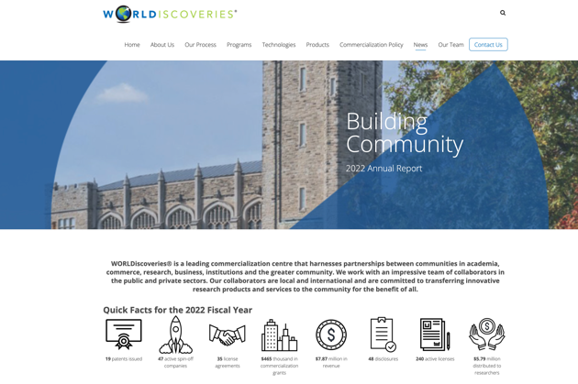
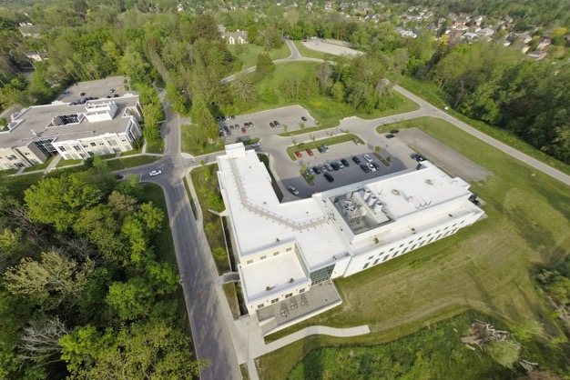
Innovation & Strategic Partnerships
Innovation & Strategic Partnerships
Concierge service focused on elevating partnerships within various sectors
WORLDiscoveries
Technology transfer & business development support & training
Western Research Parks
Programming, content & space to bring together industry, not-for-profits, government & academia
Notes:
Innovation and Strategic Partnerships: We recently introduced our portfolio to help strengthen partnerships with private, public and not-for-profit organizations.
These efforts brought together WORLDiscoveries and Western Research Parks under one unit, working alongside a newly created Innovation & Strategic Partnerships team.
Innovation & Strategic Partnerships: Seeks to elevate existing partnerships and to fill gaps where partnerships are needed to support research activities and drive innovation at Western.
Supports partnerships that are multi-year, multi-faculty, and multi-contract with private industry, government and not-for-profits.
WORLDiscoveries: Technology transfer and business development office transfers breakthroughs and innovations to the commercial sphere to serve the public’s interest and magnify Western’s global reputation and impact.
It has a portfolio of approximately 550 patents, generates $8M in licensing income annually and has led to the creation of nearly 50 spinoff companies over the past 17 years.
Western Research Parks: Promote and support private and public-sector research and development appropriate to the research activities and interests of the university and to the economic and social goals of the region, the province and the country.
Research and development activities in the Parks’ three campuses (Discovery Park, Sarnia-Lambton Research Park and Advanced Manufacturing Park) frequently involve collaboration with faculty members of the university and associated research personnel.

Slide 11
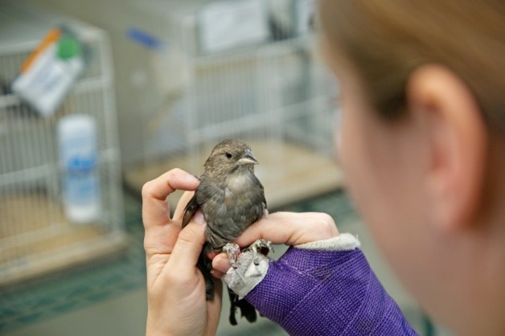

Animal Care & Veterinary Services
Animal Care
Facilities, capital equipment & staff to provide ethical care for animals
Veterinary Services
Clinical diagnostic, surgical
& consultation support
Notes:
Animal Care & Veterinary Services won’t apply to many of you, but our team supplies veterinarians, animal care technicians and other staff to support and facilitate the London research community’s ethically sound and groundbreaking research using animal models – including wildlife like birds and fishes.
Animal Care: includes facilities, like the soon-to-open Biomedical Research Facility, equipment and staff to support training, breeding, disease prevention, husbandry and excellent care.
Veterinary Services: provides a wide range of clinical and consultative services to individuals involved in animal based research, including consultations and animal-user training, veterinary on-call services; imaging, diagnostics and various related procedures.

Slide 12
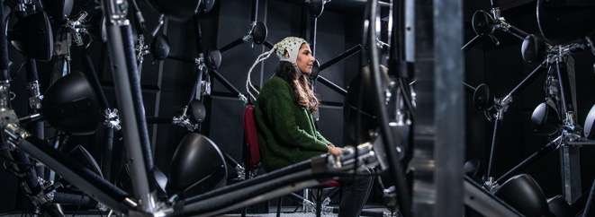

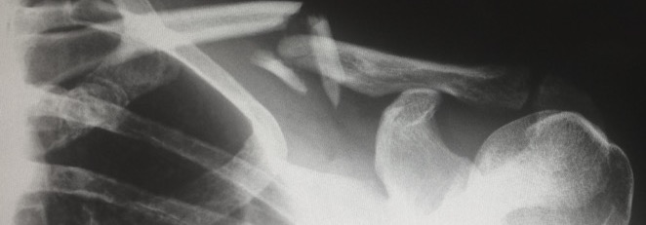

Western Research Institutes
Western Institute for Neuroscience
100+ members taking integrated approaches
to studies the brain – from gene to behaviour
Institute for Earth & Space Exploration
65+ members leading interdisciplinary research
and innovation on Earth and in space
Bone & Joint Institute
250+ members catalyzing musculoskeletal innovation with a common vision of lifelong mobility
Rotman Institute of Philosophy
60+ members bridging philosophy & science with philosophers, scientists, policy-makers & the public
Notes:
interdisciplinary connections and excellence in research.
At the end of the day, they’ve been created to enable research that would otherwise not be possible, and they play an important role in our ability build our global reputation and to tackle the grand challenges of our time.
(CONTEXT: Details about each institute to have on hand in case you’re asked; likely no need to go in to detail.)
Western Institute for Neuroscience (est. 2020): For more than 50 years, some of Western’s most internationally recognized research has related to neuroscience. Home to more than 100 investigators, the institute seeks to unlock the mysteries of the brain and to elevate and accelerate impactful neuroscience research.
Bone & Joint Institute (est. 2015): With more than 250 members, the Bone & Joint Institute brings together a critical mass of experts across disciplines achieving high-impact transdisciplinary research for the benefit of millions of Canadians suffering from pain and reduced mobility. The Institute's broad-based strengths include arthritis, bioengineering, orthopaedic surgery, regenerative medicine and sport medicine.
Institute for Earth & Space Exploration (est. 2019): Home to more than 60 researchers from nine faculties, the institute’s mission is to lead in interdisciplinary research and innovation in Earth and space exploration, and to strengthen and grow the Canadian Earth and space exploration communities by inspiring and training the next generation of scientists, engineers, social scientists and entrepreneurs.
Rotman Institute of Philosophy (est. 2021): Builds upon strengths in philosophy of science by supporting projects that bring together philosophers, scientists, policy-makers and the public at large. By building bridges between philosophy and the sciences, and drawing upon their respective strengths, its members are better able to address challenges with broad impact on Canada and the world.
Western Academy for Advanced Research (est. 2021): While not an institute per se, the Western Academy for Advanced Research brings together interdisciplinary and international teams of scholars to address major issues facing humanity through periods of dedicated focus.

Slide 13
Additional
Supports

Slide 14



Administrative Supports
Research Finance
Financial management of
research grants & contracts
Procurement Services
Procurement of goods & services, while maintaining compliance with conflict of interest & public sector accountability
Western Communications
Storytelling through writing, design, videography, digital & social engagement
Notes:
You will encounter various other administrative supports for your research, scholarship and creative activity outside of our unit, too.
This is certainly not an exhaustive list, but many of you will work with two teams in Western’s Financial Services department:
Research Finance: is involved in a wide range of activities and provides services that include financial reporting, financial analysis and forecasting, expenditure monitoring, compliance oversight, cash flow management and audit facilitation.
Procurement Services: facilitates the best-value procurement of goods and services to support of our research community and oversees policies, procedures and oversight for purchase of materials and services and related conflict of interest.
Western Communications: and I encourage you to work with Western Communications to share news of your work.
I would argue doing so is important not only because we have a responsibility to as a taxpayer-funded institution, but sharing our story can also help our own career trajectories and put us into a better position to be successful in funding opportunities, establishing partnerships or connecting our work to communities who can benefit from it.
Institutionally, it also helps us attract better students, trainees and faculty, and builds confidence among the many groups who invest in us.

Slide 15
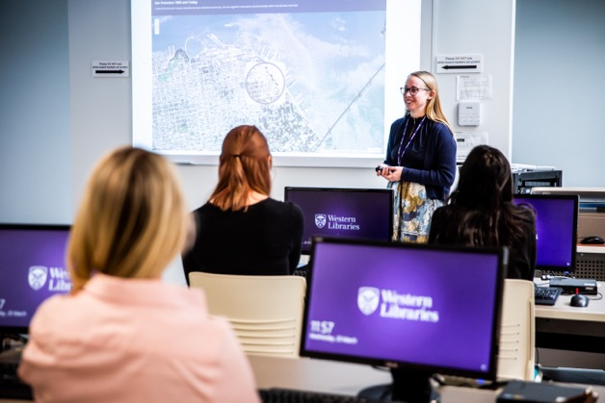


Research Supports
Western Libraries
Support for open access, data management, GIS, publishing & knowledge synthesis
Research Data Centre
Secure access to microdata from
population & household surveys
Ivey Behavioural Research Lab
Behavioural research studies in lab,
in field & online for Ivey faculty
Notes:
Moving beyond administrative supports, I’d also encourage you to find groups who can help you actually produce your research, scholarship or creative activity.
(L) Western Libraries: is more than a vast catalogue of millions of resources and special collections: many of our librarians are also researchers who are eager to connect with you to help solve problems related to creating, managing, disseminating or preserving research.
They’ll make the research process easier and more efficient for you.
Some examples include taking the guess work out of copyright; understanding the various publishing options available; learning how to harness the power of Open Access to increase impact; developing custom data management plans to research more efficiently; combining your research with geographic information systems to visualize data and explore patterns.; and getting organized with systematic and scoping reviews and other knowledge synthesis tools.
(C) Research Data Centre: Western is also a member of the Research Data Centres program, which helps strengthen Canada's social research capacity and supports the policy research community.
Staffed by Statistics Canada employees, RDCs provide researchers with access, in a secure university setting, to microdata from population and household surveys.
RDCs are located throughout the country, so researchers do not need to travel to Ottawa to access Statistics Canada data.
The centre periodically provides workshops, conferences and training about statistical techniques and the use of data.
(R) Ivey Behavioural Lab: available to Ivey Business School professors who research questions in behavioural economics, including faculty from Marketing, Organizational Behavioiur, Managerial Accounting and Control, Information Systems, Entrepreneurship.
While this opportunity applies only to a limited subset of you, I include it to stress the importance of looking around, asking questions and finding out what else might be available within your faculties or elsewhere.

Slide 16
Research
Connections

Slide 17

Icebreaker
What is your research question or goal for the year?
What knowledge, expertise or skill do you most want to develop?
What knowledge expertise or skill do you have you would like to share?

Slide 18
Welcome to Western!
westernu.ca/research
Notes:
Next slide is for the networking break ☺

Slide 19

Networking Break
Notes:
Now that we have had a high-level overview of some of the supports available to you across campus, let’s take a 15-minute networking break and have some refreshments.

Slide 20

Table Discussions
Horizon Europe & International Collaborations
Knowledge Exchange: Pathway to Research Impact
Research Partnerships & Contracts
Community-Engaged Research
Tri-Council Grant Success

Slide 21
We’re in This Together
…what can we do for you
….what can you do for each other
…what can we do together

Slide 22


