Slide 1
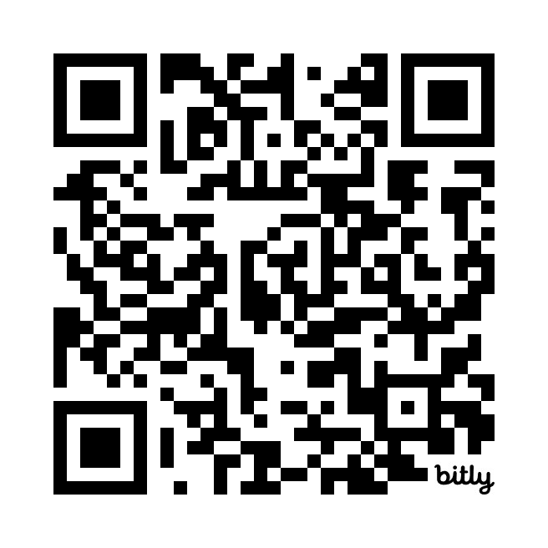
Tables Topics in Teaching
Resources available here:
https://bit.ly/nfo_2024
Facilitated by
Dani Dilkes & Ken Meadows
Centre for Teaching and Learning
These slides are licensed under an Attribution-NonCommercial-ShareAlike License.

Slide 2

Access Statement
Relevant visuals will be described​
Any disciplinary, technical, or ‘jargon’y words will be explained​
Slides have been made available to all participants​
Live captioning is on

Slide 3
Topics in Teaching
Surveyed you asking you to vote on two topics in teaching and learning you would like to learn more about and discuss at your tables
    Generative AI in Teaching and Learning (80%)
    Student Engagement (50%)

Slide 4
Format of Session
  5-minute introductions at your table
  Two 20-minute rounds
      10-minute presentation
      10-minute discussion at your table
  Wrap Up

Slide 5
Introductions
  Introduce yourself to others at your table (5 minutes)
    Your name
    Your discipline
    What is one thing you are looking forward to in the upcoming year?

Slide 6

Supporting Student Engagement by Building Community in your Courses

Slide 7
Defining Community
Belonging
Connection to Learning
Feelings of inclusion, of being valued as a person
Sense of both benefitting from and contributing to the course, actively making meaning
Rovai (2002)

Slide 8
Building Community
Connecting with the students
Connecting students with each other
Connecting students with the course
Centre for Teaching Excellence (n.d.); Moore (1989)

Slide 9
Connecting with Students: Learn about Them
Learn their names, with proper pronunciations, and pronouns (if they share them)
Learn about them as learners
    For example, survey them about…
        Knowledge they are coming in with
        Why they are taking the course
        What most interests them about the course
        “What would you like me to know about you as a learner?”
        Get feedback on their learning during the course

Slide 10
Connecting with Students: Let them Learn about You
Share how to contact you
    Office hours, email, through OWL Brightspace
    As possible, be available before and/or after class
As you are comfortable, share a little about yourself (e.g., why you are passionate about your discipline; an outside interest)

Slide 11
Connecting Students with Each Other
Icebreaker on the first day (and later; e.g., in pairs, share one thing that you are comfortable sharing about yourself; what is one thing about [the discipline] that interests you).
Build interactivity into learning activities & assessments (e.g., small group discussions; OWL Brightspace Discussions; group work; peer feedback)

Slide 12
Connecting Students with the Course
Ensure course materials are accessible
When possible, provide real world examples; tailor content and/or examples to students’ knowledge, interests, experiences, future careers
Connect students with campus resources at relevant points throughout the course and normalize their use (“…part of being a student”; e.g., Learning Development & Success, Wellness & Well-being)

Slide 13
Connecting Students with the Course (continued)
Co-create a community agreement: Shared expectations for each other and the course (e.g., respectful communication, turn taking in discussions)
When possible, provide flexibility and choice (e.g., choice of topics for an assignment)
Emphasize learning is a process, discuss importance of making mistakes for learning

Slide 14
Discussion Questions: Building Community
What have you previously done to build community in your courses?
What else might you consider doing to build community in your courses?
How else do you support students’ engagement in their learning?

Slide 15

Big Hero Six or
The Terminator?
Understanding GenAI Through Metaphors
Facilitated by:
Dani Dilkes eLearning & Curriculum Specialist
Image generated using ChatGPT 4o in August 2024 in response to the prompt “generate an image of big hero six VS the terminator as a metaphor for AI”

Slide 16

What IS Generative AI?
Artificial Intelligence tool that creates new content
Trained on massive datasets to identify patterns and connections
Image generated using Midjourney in December 2023 in response to the prompt “What is generative AI?”

Slide 17

AI Metaphors
Metaphors tell us a lot about how people feel about and perceive Artificial Intelligence (Gupta et. al., 2024)
Image generated using ChatGPT 4o in August 2024 in response to the prompt “generate an image of the metaphor "black box" “

Slide 18
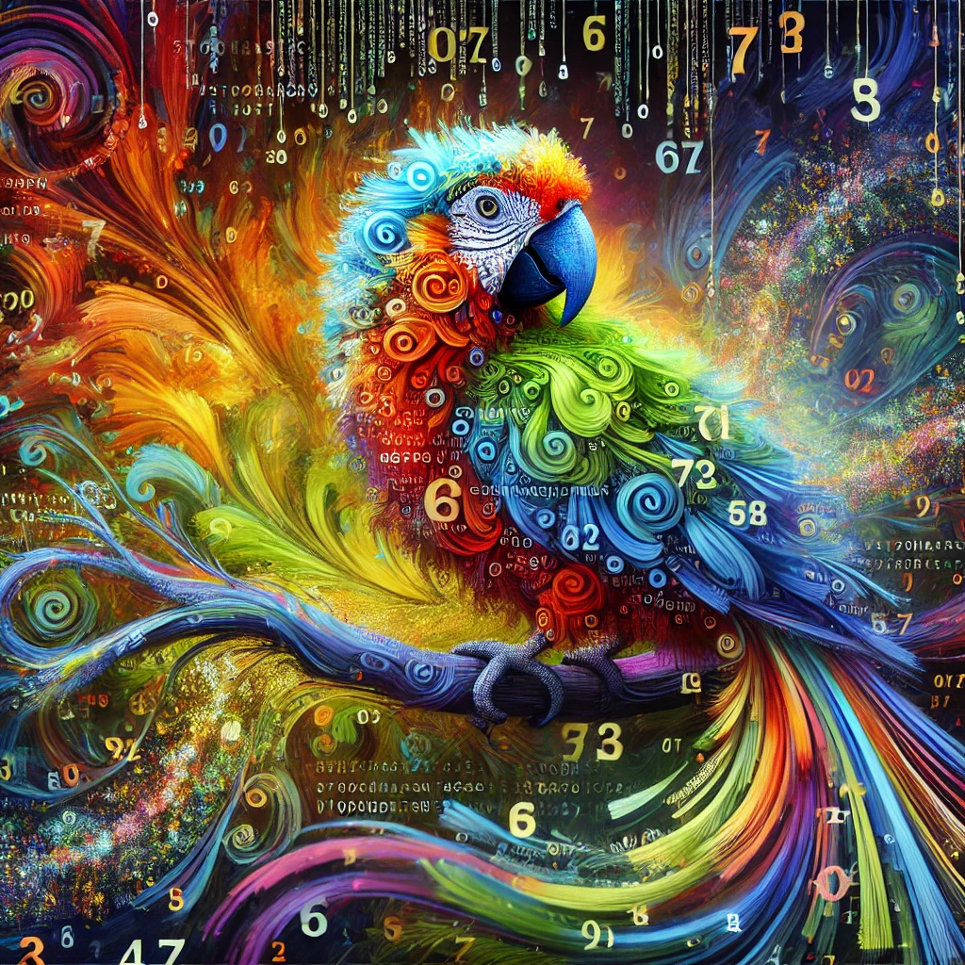
Stochastic Parrot
Replicates language patterns
Limited to the data sets that it’s been trained on
Lacks comprehension
Not concerned about facts
Image generated using ChatGPT 4o in August 2024 in response to the prompt “generate an image of the metaphor "stochastic parrot“”

Slide 19

Over-Eager Intern
Responds to prompting
Good at low-level cognitive tasks (defining, summarizing)
Appears to do all of the things
Isn’t critical or reflexive
Prone to misinformation
Image generated using ChatGPT 4o in August 2024 in response to the prompt “generate an image of the metaphor "an over-eager intern“.

Slide 20

Digital Kaleidoscope
Generates new content/ patterns from existing content
Prone to nonsensical output (hallucinations)
Image generated using ChatGPT 4o in August 2024 in response to the prompt “generate an image of the metaphor "digital kaleidoscope“”.

Slide 21

Fast Food
Low-effort mass production
Style over substance
Environmental impact
Lacks transparency
Image generated using ChatGPT 4o in August 2024 in response to the prompt “generate an image of the metaphor "digital fast food“”

Slide 22
Discussion Questions
What metaphor(s) align best with your understanding of or beliefs about GenAI? Why?
What hopes do you have for GenAI in education or academia?
What concerns do you have about GenAI for education or academia?

Slide 23

Upcoming AI Sessions
teaching.uwo.ca
August 29th 2:00 - 3:00
Generative AI Community of Practice
September 23rd 1:00 - 2:00
Introduction to Generative AI in Teaching and Learning
October 3rd, 2:00 - 3:00
Rethinking Academic Integrity in a GenAI World
October 30th, 11:00 to 12:00
Generative AI for UDL and Accessibility

Slide 24
Upcoming Universal Design for Learning (UDL) Sessions teaching.uwo.ca
September 19; 2:30 - 3:50pm
September Meeting of the Inclusive Teaching Community of Practice
September 26; 9:30-11:00am
Introduction to Universal Design for Learning and the UDL Certificate
October 23; 1:30-3:00pm
UDL: Multiple Means of Representation
October 31; 1:30-3:00pm
UDL: Multiple Means of Action & Expression
November 12; 10:30am-12:00pm
UDL: Multiple Means of Engagement

Slide 25
References and Resources
  Centre for Teaching Excellence (n.d.). Building community in large classes. University of Waterloo.
  https://uwaterloo.ca/centre-for-teaching-excellence/catalogs/tip-sheets/building-community-large-classes
  Centre for Teaching and Learning (n.d.). Accessibility boosts. Western University.
  https://teaching.uwo.ca/elearning/accessibilityboosts.html
  Centre for Teaching and Learning (n.d.). Accessibility in teaching. Western University.
  https://teaching.uwo.ca/teaching/accessibility-in-teaching.html
  Centre for Teaching and Learning (n.d.). Building community. Western University.
  https://teaching.uwo.ca/teaching/engaging/building-community.html
  Centre for Teaching and Learning(n.d.). Certificate in Universal Design for Learning. Western University.
  https://teaching.uwo.ca/programs/certificates/udl.html
  Centre for Teaching and Learning (n.d.). First day of class. Western University.
  https://teaching.uwo.ca/teaching/engaging/firstday.html
  Centre for Teaching and Learning (n.d.). Generative AI resources. Western University.
  https://teaching.uwo.ca/elearning/generativeAI-resources.html
  Center for Teaching, Learning & Technology. (n.d.) Building community and creating an inclusive learning
  environment. California Polytechnic State University.
  https://ctlt.calpoly.edu/building-community-and-inclusive-learning-environment

Slide 26
References and Resources (continued)
  Gupta, A., Atef, Y., Mills, A., & Bali, M. (2024). Assistant, parrot, or colonizing loudspeaker? ChatGPT metaphors for developing critical AI literacies. Open Praxis, 16(1), 37–53.
  https://doi.org/10.55982/openpraxis.16.1.631
  Moore, M. G. (1989). Editorial: Three types of interaction. American Journal of Distance Education, 3(2), 1-6.
  Office of Faculty Relations (n.d.). Faculty (UWOFA). Western University.
  https://www.uwo.ca/facultyrelations/faculty_relations/faculty/index.html
  Rovai, A. P. (2002). Sense of community, perceived cognitive learning, and persistence in asynchronous learning networks. Internet and Higher Education, 5, 319-332.
  https://doi.org/10.1016/S1096-7516(02)00130-6
  Student Experience (n.d.). Accessible education. Western University.
  http://academicsupport.uwo.ca/accessible_education/index.html
  Student Experience (n.d.). Learning development and success. Western University. https://learning.uwo.ca/
  Teaching Assistants Training Program (n.d.). Community agreements. University of Toronto.
  https://tatp.utoronto.ca/resources/community-agreements/
  Teaching Assistants Training Program (n.d.). Building a community online. University of Toronto.
  https://tatp.utoronto.ca/resources/building-a-community-online/
  Uncovering the Hidden Curriculum (n.d.). Uncovering the hidden curriculum: Supporting learners and educators within and beyond education. https://hiddencurriculum.ca/
  Western Technology Services (n.d.). iClicker. Western University. https://wts.uwo.ca/iclicker/

