Slide 1

Wellness and Well-being

Slide 2
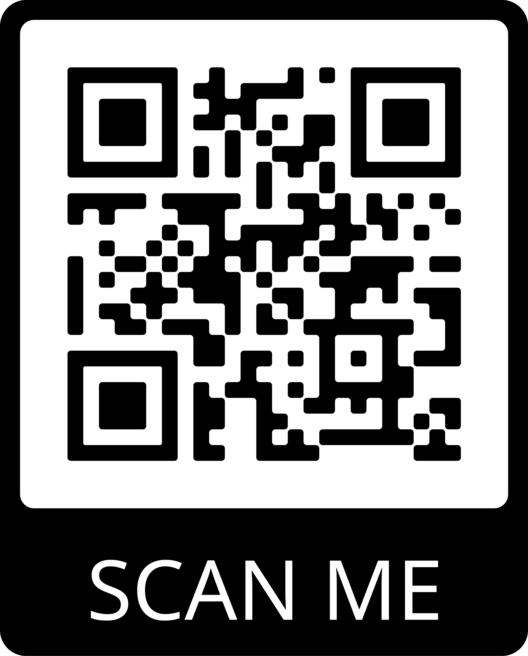

Supports & Services
Wellness Support can be found in Thames Hall.
You may book an appointment by calling 519-661-3030 or scan the QR code to access Wellbeing Resources for Western Students.
Office of Equity, Diversity & Inclusion
WELLNESS AND WELL-BEING SUPPORTS & SERVICES

Slide 3

Health and Wellness Services
Student Health and Wellness
  Provide students with services in:
    Primary health care
    Sleep hygiene
    Trans care
    Physicians/Psychiatry
  Some appointments are available same/next day and can be booked online
Employee & Family Health Clinic
  Located in Thames Hall Wellness and Well-being Centre
  Applications for Employee & Family Health Clinic are available on the website. www.uwo.ca/health/shs/employee-family-health.html
Contact: health@uwo.ca (general questions)
Phone: 519-661-3030 (concerns regarding a specific student)

Slide 4
Mental Health Team
Stepped Care Model
  Provide single session, short-term, and group support for a range of stressors relating to the transition to university, mental health concerns, academic stress, grief, race, and belonging.
Fall Group Programming
  Offer series of group care workshops that run 6-8 weeks in length including Trans Care, Black and Racialized Students, Distress Tolerance, Grad Support, Anxiety 101
  Check here for fall list: www.uwo.ca/health/psych/group_care.html
Contact: health@uwo.ca (general questions)
Phone: 519-661-3030 (concerns regarding a specific student)
Same Day / Next Day Care
  Students can be seen on an urgent basis if in crisis (seen within a few hours and during clinic hours).

Slide 5
Student Support & Case Management
Student Support and Case Managers
  Work with students to explore options and develop an action plan for navigating resources in the community.
Gender-based Violence and Survivor Support Case Managers
  Offer services to help prevent, respond to and support survivors.
  Survivor have the right to make a formal complaint.
    survivorsupport.uwo.ca and uwo.ca/health/gbsv/response/report.html
Behavioural Intervention and Conduct Case Manager
  Uphold the Code of Student Conduct and the process for non-academic violations of the Code
  Conduct investigations of complaints (Student Code, GBSV)
Contact:
  sscm@uwo.ca (General)
  student.case.manager@uwo.ca (Student Support specific)
  support@uwo.ca (GBV specific)
  studentconduct@uwo.ca (Code specific)
Phone: 519-661-2111 ext. 89152

Slide 6
Wellness & Equity Education
Provide Collaborative Programming with Campus Partners
  Wellness & Harm Reduction Education
    Provide preventative education opportunities contributing towards a more supportive, inclusive and thriving campus
  Gender-based and sexual violence (GBSV) Prevention and Education
    Gain the skills to address and prevent GBSV
  Equity Diversity and Inclusion (EDI) Education & Programming
    Provide workshops of anti-oppression and anti-marginalization
  Chaplaincy and Spiritual Services
    Maintain multifaith spaces on campus and liaise with spirituality-oriented stakeholders
Contact: AnnaLise Trudell (Manager), Email: atrudel3@uwo.ca

Slide 7
THANKS!
Any Questions?
www.health.uwo.ca

