Slide 1

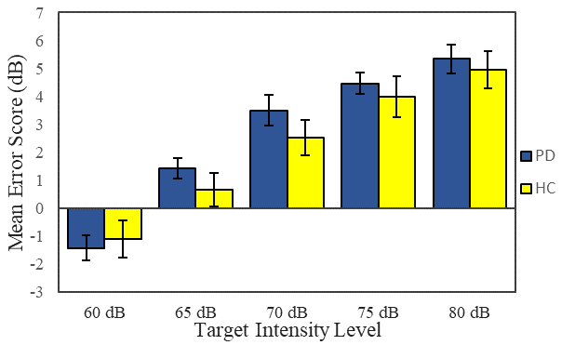
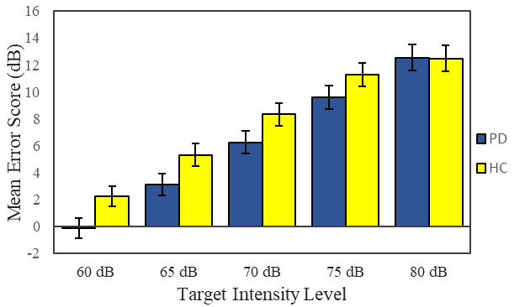
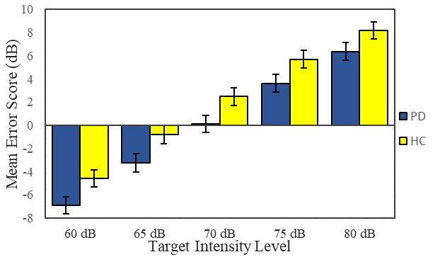
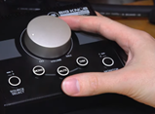
Speech Loudness Matching in Individuals with Parkinson’s Disease and Hypophonia
Scott Adams_{1,2,3}, Catherine Johnson ₂, Julie Theurer_{1,2}, Allyson Page_{1,2}, and Mandar Jog₃
¹ School of Communication Sciences & Disorders, ² Health and Rehabilitation Sciences, ³ Department of Clinical Neuroscience, Western University, London, Ontario, Canada
Introduction
Results
Results
Results
Previous research indicates that the hypophonia associated with Parkinson’s disease (PD) may be related to a deficit in speech loudness perception_{1,2,3}. The loudness matching paradigm₄ allows for a new approach to the evaluation and comparison of the loudness perception of external speech and self-vocalized speech in PD. The paradigm also allows for the evaluation of the effects of speech amplification on self- loudness perception. The purpose of the present study was to examine loudness perception in individuals with hypophonia and PD using speech loudness matching procedures.
Loudness Matching of Manually Controlled
External Speech
Loudness Matching of Manually Controlled
External Speech:
No significant group difference (p = .58) or interaction (p = .39) was found. There was a significant main effect of the loudness level (p = < .001) and this was reflected by a gradual increase in error scores as the loudness target increased.
2. Loudness Matching of Self-vocalized Speech
3. Amplified (+10dB) Self-vocalized Speech
*
Methods
*
*
*
Fifteen individuals with PD and hypophonia (mean age 67.7; SD = 5.5) and 15 healthy control (HC) participants (mean age 70; SD = 6.5). Conversational intensity of the PD group (M= 69.2dB) was significantly lower than the HC group (M= 71.7dB). All participants passed hearing screening of 0.5, 1 & 2 kHz tones at 30dB.
Participants performed sentence-based loudness matching procedures involving speech loudness targets randomly presented at 5 intensity levels (60-80dBC SPL). The sentence “I owe you a yoyo” was used throughout the study.
The loudness matching tasks included,
a manual volume control knob to adjust
the audio playback level of external speech,
2) self-vocalized speech, and
3) amplified (+10dB) self-vocalized speech.
A microphone (AKG-SE300B-CK92) placed 2 meters from the participant and two loudspeakers (Yamaha:HS-8) were used to measure the target and response speech intensity. A large (5cm) knob was used to adjust the playback volume (Mackie Big Knob). A headset mic (AKG 520c) and mic preamp (ART Pro) were used to amplify speech (+10dB).
The primary dependent measure was the loudness matching error score (i.e., target intensity minus response intensity). ANOVAs were used to examine mean differences related to group, loudness levels, and response conditions.
1
*
Figure 2. Mean error scores for PD and HC groups obtained for the 5 loudness
matching levels during the condition involving the self-vocalized speech responses.
Figure 3. Mean error scores for PD and HC groups obtained for the 5 loudness
matching levels during the condition involving the amplified (+10 dB) self-vocalized speech responses.
Figure 1. Mean error scores for PD and HC groups obtained for the 5 loudness
matching levels during the condition involving manually controlled external speech
responses.
The finding that the PD group had better loudness matching scores than the HC group was unexpected and appears to be contrary to the predicted loudness matching deficit for the PD group.
Condition 1 vs 2: The results related to the comparison of the external versus self-vocalized matching found that PDs had higher error scores than HCs for external loudness matching and lower error scores than HCs during self-vocalized loudness matching.
3. Amplified (+10dB) Self-vocalized Speech:
There was a significant group effect (p = .037) with PD participants having a significantly smaller mean error score (M = -.005) than the HC participants (M = 2.19). There was a significant main effect of the loudness level (p = < 0.001). The group by loudness level interaction was not significant (p = .78).
The post-hoc analysis revealed that the PD group had a significantly lower error score than the HC group during the lower loudness levels (60dB, 65dB and 70dB).
Condition 2 vs 3: The comparison of amplified versus unamplified responses was significant (p=<0.001). The 10dB amplified responses were associated with lower error scores (better loudness matching) than the unamplified responses for both the PD and HC groups.
Conclusions
In summary, for the loudness matching conditions involving self-vocalized (imitation) responses, the PD group had lower error scores than the HC group, especially for the lower intensity targets (60, 65 and 70dB). In order to achieve these lower error scores, the PD group produced significantly higher intensity responses than the HC group.
These results are contrary to previous loudness matching or imitation studies in PD1,2. This finding of a PD group having better performance than a HC group is relatively unique in the field of motor speech disorders. Potential causal factors to be considered include, the ordering of experimental conditions, and the facilitating effect of a preceding limb (manual) sensorimotor task. Future studies are needed to examine these unique and potentially important loudness matching results in PD.
2. Loudness Matching of Self-vocalized Speech:
The group effect was not significant (p = .15). There was a significant main effect of the loudness level (p = < .001).
A significant group by loudness level interaction was found (p = .012). This significant interaction indicates that the PD group attained a significantly lower error score than the HC group at the lower loudness levels (60-65dB), but not at the higher loudness levels (75-80dB).
In order to achieve these lower error scores during the self-vocalized loudness matching task, the PD group produced significantly higher speech intensity responses than the HC group.
Loudness Matching Task Setups
References:
1. Clark, J. P., Adams, S. G., Dykstra, A. D., Moodie, S., & Jog, M. (2014). Loudness perception and speech intensity control in Parkinson's disease. Journal of Communication Disorders, 51, 1–12.
2. De Keyser, K., Santens, P., Bockstael, A., Botteldooren, D., Talsma, D., De Vos, S., Van Cauwenberghe, M., Verheugen, F., Corthals, P., & De Letter, M. (2016). The Relationship Between Speech Production and Speech Perception Deficits in Parkinson’s Disease. Journal of Speech, Language and Hearing Research, 59, 915-931.
3. Ho, A. K., Bradshaw, J. L., & Iansek, R. (2000). Volume perception in Parkinsonian Speech. Movement Disorders, 15(6), 1125–1131.
4. Marks, L. E., & Florentine, M. (2011). Chapter 2 Measurement of Loudness, Part I: Methods, Problems, and Pitfalls. In Loudness (pp. 17–56). essay, Springer.
1) manual volume control knob
to adjust the audio playback
level of external speech
2) self-vocalized speech
3) amplified (+10dB)
self-vocalized speech

