Slide 1
Noun and Verb phrase elaboration
By: Tanaya Rose

Slide 2
Broader Perspective of Grammatical Development
  In the field of speech language pathology, perspectives of grammatical development have focused on mean length of utterance (MLU) and grammatical morphemes, such as plural –s and progressive –ing (Owens, Pavelko, & Bambinelli, 2018).
  While MLU and grammatical morphemes have their clinical utility, it is important to take a broader approach to grammatical development by also focusing on the grammatical targets of noun phrase elaboration, verb phrase elaboration, and complex syntax.
  Children with language impairments (LI) produce (Eisenberg, 2013):
      Fewer two and three element noun phrases than their typically developing peers
      Less elaborate verb phrases
      Fewer complex sentences

Slide 3

Overview of objectives
From this PowerPoint presentation you will learn:
How to identify elements of elaborated noun phrases (ENPs) and elaborated verb phrases (EVPs)
How to use sentence-combining techniques to facilitate noun phrase elaboration

Slide 4
Identifying A Noun Phrase: The Main VERB
How do you know what group of words form a noun phrase (NP) in a sentence?
Begin by locating the main verb in the sentence. Ask yourself:
      What is the action that the subject is doing (Writing Explained, n.d.)?
      What is the most important verb in the sentence?
      Example: “The really tall giraffe at the zoo ate the green leaves off the tree.”
Notes:
Writing Explained. (n.d.). What is a main verb? Definitions, examples of main verbs. Retrieved from https://writingexplained.org/grammar-dictionary/main-verb

Slide 5
Identifying A Noun Phrase: Substitution Test
Once you have located the main verb, ask yourself what words before/after the main verb can be substituted by a single pronoun.
      Examples:
        “The really tall giraffe at the zoo ate the green leaves off the tree.” → “He ate them.”
        “The silly frog hopped over the fence.”→ “He hopped over it.”
        “Playing soccer all day made the boy tired.” → “It made him tired.”
        “The toy car was going really fast.”→ “It was going really fast.”
      If the string of words can be substituted by a single pronoun, you have evidence that those words form a noun phrase!

Slide 6
Elaborated noun phrase (ENP) Elements
The most basic noun phrase consists of only a single word/noun.
    Example: “Bears like honey.”
Children can expand on a single noun by using the following elements:
    Articles
    Possessive pronouns
    Adjectives
    Descriptors
    Quantifiers
    Demonstratives
    Numerical Terms
Notes:
Owens, R. E., Pavelko, S. L., Bambinelli, D. (2018). Moving beyond mean length of utterance: Analyzing language samples to identify intervention targets. Perspectives of the ASHA Special Interest Groups, 3(SIG 1), 5-22. doi:10.1044/persp3.SIG1.5

Slide 7
ENP Elements: Articles
What is an article?
      A function word that determines if the speaker is referring to a specific or unspecific noun (Grammarly, n.d.).
The definite article the
      Used when the speaker is referring to a specific noun
      Example: “Pass me the cup.”
      Meaning: there is a specific cup that the individual wants passed to them.
The indefinite article a/an
      Used when the speaker is referring to an unspecific noun
      Example” “Pass me a cup.”
      Meaning: the individual is not requesting a specific cup.
ENP: Article + Noun
Notes:
Grammarly. (n.d.). Articles. Retrieved from https://www.grammarly.com/blog/articles/

Slide 8
ENP Elements: Possessive pronouns
What are possessive pronouns?
    Pronouns that convey ownership
    They do NOT contain an apostrophe
    Independent possessive pronouns
        Can stand alone: replace a noun in a sentence
        Example: “The book on the desk is Sally’s.” → “The book on the desk is hers.”
Independent Possessive Pronouns
mine | ours
yours | yours (pl)
his | theirs
hers | its
Notes:
Owens, R. E., Pavelko, S. L., Bambinelli, D. (2018). Moving beyond mean length of utterance: Analyzing language samples to identify intervention targets. Perspectives of the ASHA Special Interest Groups, 3(SIG 1), 5-22. doi:10.1044/persp3.SIG1.5

Slide 9
ENP Elements: Possessive pronouns Continued
    Dependent possessive pronouns (aka possessive adjectives)
        Can NOT stand alone: occur before a noun
        “His train set.” vs “The train set was his.”
                Dependent vs independent
        ENP Example: Possessive Pronoun + Noun
        *** Owens et al. (2018) also count independent possessive pronouns as an element of an ENP.
Dependent Possessive Pronouns
my | our
your | your (pl)
his | their
her | its
Notes:
Owens, R. E., Pavelko, S. L., Bambinelli, D. (2018). Moving beyond mean length of utterance: Analyzing language samples to identify intervention targets. Perspectives of the ASHA Special Interest Groups, 3(SIG 1), 5-22. doi:10.1044/persp3.SIG1.5

Slide 10
ENP ELEMENTS: Adjectives
What is an adjective?
  A word that modifies or describes a noun.
  It must occur in a noun phrase to be considered an element of an ENP.
  Possessive noun
    Noun that conveys ownership
    Contains an apostrophe
    Example: “Dad’s new car.”
    Incorrect example: “The new car is Dad’s,” as Dad’s is not modifying a noun in a NP.
  Ordinal
    Conveys position in a series (e.g., first, second, last, next)
    Occurs before a noun
    Example. “He won first place in the race.”
    Incorrect example: “He will always come first,” as first is not modifying a noun; thus, is not an ENP.
Notes:
Owens, R. E., Pavelko, S. L., Bambinelli, D. (2018). Moving beyond mean length of utterance: Analyzing language samples to identify intervention targets. Perspectives of the ASHA Special Interest Groups, 3(SIG 1), 5-22. doi:10.1044/persp3.SIG1.5

Slide 11
ENP ELEMENTS: Adjectives Continued
Adverb
    An adverb is considered an adjective when it modifies an adjective (e.g., really, very)
    Example: “She was a very happy girl.”
    Incorrect example: “The girl was very happy,” as “very happy” is an adjective phrase, not a noun phrase.
Adjective
    Occurs before a noun
    Describes a quality of the noun
    Example: “The funny puppy rolled over.”
    Incorrect example: “The puppy was funny,” as funny is in its own adjective phrase, not a noun phrase.
    ENP Example: Article + Adjective + Noun
Notes:
Owens, R. E., Pavelko, S. L., Bambinelli, D. (2018). Moving beyond mean length of utterance: Analyzing language samples to identify intervention targets. Perspectives of the ASHA Special Interest Groups, 3(SIG 1), 5-22. doi:10.1044/persp3.SIG1.5

Slide 12
ENP ELEMENTS: Descriptor
What is a descriptor?
    An open compound noun → noun + noun
      The first noun modifies the second noun.
      There is a space between the two nouns.
    A descriptor is considered a type of adjective by Owens et al. (2018), but is counted separately from adjectives when scoring the language sample.
    Examples:
      “Fish tank”
      “Bus stop”
      “Apple tree”
    ENP Example: Article + Descriptor
NP
NP
N^{I}
N^{I}
Noun 1
Noun 2
Notes:
Owens, R. E., Pavelko, S. L., Bambinelli, D. (2018). Moving beyond mean length of utterance: Analyzing language samples to identify intervention targets. Perspectives of the ASHA Special Interest Groups, 3(SIG 1), 5-22. doi:10.1044/persp3.SIG1.5

Slide 13
ENP ELEMENTS: Quantifier
What is a quantifier?
    A function word that specifies an amount.
    Example: “I would like some cake.”
    ENP Examples:
    Quantifier + Article + Noun → “I would like some of the cake.”
    Quantifier + Possessive Pronoun + Noun → “All of my friends are nice.”
Quantifiers
some | a lot
any | a few
much | several
many | enough
Notes:
Owens, R. E., Pavelko, S. L., Bambinelli, D. (2018). Moving beyond mean length of utterance: Analyzing language samples to identify intervention targets. Perspectives of the ASHA Special Interest Groups, 3(SIG 1), 5-22. doi:10.1044/persp3.SIG1.5

Slide 14
ENP ELEMENTS: Demonstrative
What is a demonstrative?
    A function word that indicates the identity of the thing being referred to by the subsequent noun.
    Example: “Look at that bird.”
    ENP Example: Quantifier + Demonstrative + Noun → “Some of those apples have gone bad.”
Demonstrative
this | that
these | those
Notes:
Owens, R. E., Pavelko, S. L., Bambinelli, D. (2018). Moving beyond mean length of utterance: Analyzing language samples to identify intervention targets. Perspectives of the ASHA Special Interest Groups, 3(SIG 1), 5-22. doi:10.1044/persp3.SIG1.5

Slide 15
ENP ELEMENTS: Numerical term
What is a numerical term?
    A function word that conveys an actual or specific number (e.g., one, two, three…).
    Example: “Goldilocks and the three little pigs.”
    ENP Example: Quantifier + Numerical + Noun → “All four dogs had black spots.”
FOUR
EIGHT
ONE
TWO
SIX
FIVE
SEVEN
THREE
Notes:
Owens, R. E., Pavelko, S. L., Bambinelli, D. (2018). Moving beyond mean length of utterance: Analyzing language samples to identify intervention targets. Perspectives of the ASHA Special Interest Groups, 3(SIG 1), 5-22. doi:10.1044/persp3.SIG1.5

Slide 16
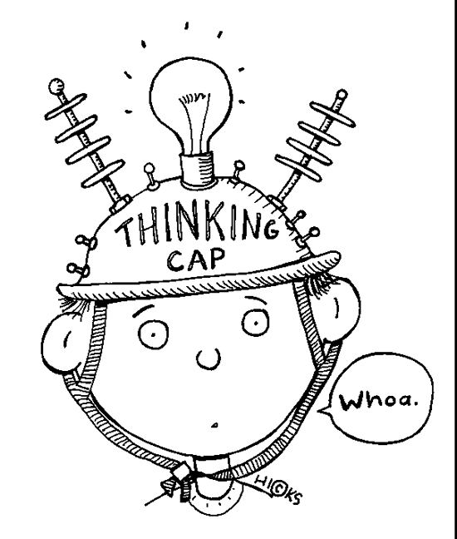
ENP ELEMENTS: Trickier cases
Embedded clauses
  A clause that is inserted into the main clause.
  It contains its own subject and verb; thus, it contains its own NP(s).
  Example One: “The waitress who served us our food was friendly.”
    NP in the main clause: “the waitress”
    NP in the embedded clause: “our food”
  Example Two: “The soup, that’s in the pot, is very hot.”
    NP in the main clause: “the soup”
    NP in the embedded clause: “the pot”

Slide 17
Elaborated VERB phrase (EVP) Elements
Like NPs, as children develop, they also produce more elaborate verb phrases (VPs).
Elements of EVPs include:
    BE copula
    Irregular past
    Infinitive phrases
    Prepositional phrases
    BE Auxiliary
    Do/does + verb
    Modal Auxiliaries
NOTE about gerunds: a gerund functions as a noun even though it looks like a verb.
Examples:
  “Talking in the library is not allowed.”
  “She loves singing.”
    “Singing” could be replaced by an object and the sentence would still make sense.
Notes:
Owens, R. E., Pavelko, S. L., Bambinelli, D. (2018). Moving beyond mean length of utterance: Analyzing language samples to identify intervention targets. Perspectives of the ASHA Special Interest Groups, 3(SIG 1), 5-22. doi:10.1044/persp3.SIG1.5

Slide 18
EVP ELEMENTS: Be copula
When the verb “be” is used as the main verb in the sentence, it is called a copula.
    Example: “The kitten was sleepy.”
Be Copula
is
am
are
was
were
Notes:
Owens, R. E., Pavelko, S. L., Bambinelli, D. (2018). Moving beyond mean length of utterance: Analyzing language samples to identify intervention targets. Perspectives of the ASHA Special Interest Groups, 3(SIG 1), 5-22. doi:10.1044/persp3.SIG1.5

Slide 19
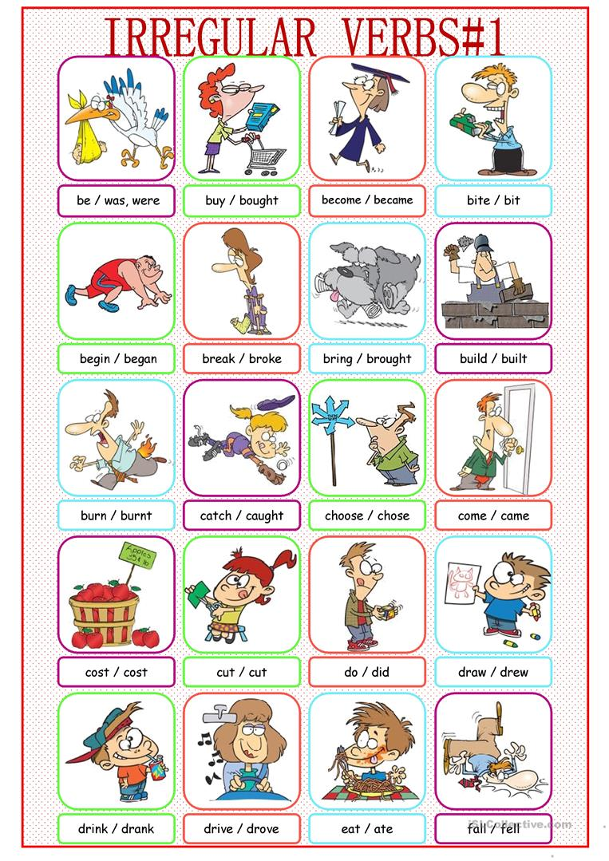
EVP ELEMENTS: Irregular past
Some verbs are not inflected with the regular past tense marker –ed.
    Instead, they change forms when in the simple past tense.
    Examples:
        Choose → chose
        Eat → ate
        Hear → heard
        Freeze → froze
        Speak → spoke
Notes:
Pictures: Kissnetothedit. (2013). Irregular verbs picture dictionary#1. Retrieved from https://en.islcollective.com/english-esl-worksheets/grammar/past-simple-tense/irregular-verbs-picture-dictionary1/45408

Slide 20

EVP ELEMENTS: Infinitive phrases
Infinitives have the structure to + simple form of the verb.
  The simple form of the verb has no inflection or tense marking: it is the root/stem form.
  When infinitive phrases occur after a verb, they are technically gerunds, as they can be replaced with a noun and the sentence would still make sense.
    An infinitive phrase is considered an element of an EVP regardless of if it is a gerund.
  Examples:
    “She loves to read.”
    “I like to bake chocolate chip cookies.”
Notes:
Owens, R. E., Pavelko, S. L., Bambinelli, D. (2018). Moving beyond mean length of utterance: Analyzing language samples to identify intervention targets. Perspectives of the ASHA Special Interest Groups, 3(SIG 1), 5-22. doi:10.1044/persp3.SIG1.5

Slide 21
EVP ELEMENTS: Prepositional phrases (PP)
Prepositional phrases contain a preposition and a NP (P + NP).
    Prepositional phrases are complements of the verb.
    Examples:
      “The fireman went up the ladder.”
      “I keep my bicycle in the garage.”
PP
P^{I}
NP
Preposition
Noun Phrase
Notes:
Owens, R. E., Pavelko, S. L., Bambinelli, D. (2018). Moving beyond mean length of utterance: Analyzing language samples to identify intervention targets. Perspectives of the ASHA Special Interest Groups, 3(SIG 1), 5-22. doi:10.1044/persp3.SIG1.5

Slide 22
EVP ELEMENTS: BE Auxiliary
The verb “be” functions as an auxiliary when it supports the main verb.
    It helps supply tense information.
    Examples:
        “She was walking on the sidewalk.”
        “He’s singing in the school concert.”
    Incorrect example:
        “One of my favourite things is painting.”
          “Is” functions as a copula here, as “painting” is a gerund.
Tense Phrase
Be Auxiliary
is | were
am | been
are | being
was
VP
T^{I}
BE Auxiliary
Verb Phrase
Notes:
Owens, R. E., Pavelko, S. L., Bambinelli, D. (2018). Moving beyond mean length of utterance: Analyzing language samples to identify intervention targets. Perspectives of the ASHA Special Interest Groups, 3(SIG 1), 5-22. doi:10.1044/persp3.SIG1.5

Slide 23
EVP ELEMENTS: Do/Does + Verb
The verb “do” can also function as an auxiliary or “helping” verb.
    Examples:
      “She does look nice in her yellow dress.”
      “He doesn’t eat brussels sprouts.”
___ + verb
do
does
don’t
doesn’t
Notes:
Owens, R. E., Pavelko, S. L., Bambinelli, D. (2018). Moving beyond mean length of utterance: Analyzing language samples to identify intervention targets. Perspectives of the ASHA Special Interest Groups, 3(SIG 1), 5-22. doi:10.1044/persp3.SIG1.5

Slide 24
EVP ELEMENTS: MODAL AUXILARIES
Modal auxiliaries express (Grammarly, n.d.):
    Possibility
    Permission
    Ability
    Obligation
Modal Auxiliaries
can | used to
could | ought to
may | shall
might | should
must | will
need | would
Notes:
Grammarly. (n.d.). Modal verbs: Definition and usage. Retrieved from https://www.grammarly.com/blog/modal-verbs/

Slide 25
Intervention Idea for Noun phrase elaboration: Sentence-Combining
  Sentence combining is a writing intervention that involves systematic instruction and structured practice (Saddler & Asaro-Saddler, 2010).
  While technically a writing intervention, its strategies can be applied to oral language intervention.
  The child practices combining two or more short sentences into a more complex sentence.
  If a clinician was targeting articles and adjectives, as well as expanding ENPs to three elements, they could get the child to practice combining sentences such as:
    Base clause: The bird sat in the nest.
    Sentence to be combined: The bird is red.
    Combined: The red bird sat in the nest.
    Result: The child produced a three-element ENP that has both an article and an adjective: “the red bird.”

Slide 26
Sentence-Combining: Practice
After tallying the results of a 50-utterance language sample, you decide to work on thee element NPs that contain a possessive pronoun and an adjective. What sentence could be combined with the following base sentence to get the desired result?
Base Sentence: My bicycle is in the shed.
Sentence to be combined:

Slide 27
Sentence-Combining: Practice Continued
Example sentences to be combined:
  “My bicycle is purple.”
  “My bicycle is new.”
  Once the child is successful with combining two sentences, you could work on combining more than two sentences to get NPs with multiple adjectives, such as:
  “My new purple bicycle is in the shed.”

Slide 28
References
Eisenberg, S. L. (2013). Grammar intervention: Content and procedures for facilitating children's language development, Topics in Language Disorders, 33(2), 165-178. doi:10.1097/TLD.0b013e31828ef28e
Grammarly. (n.d.). Articles. Retrieved from https://www.grammarly.com/blog/articles/
Grammarly. (n.d.). Modal verbs: Definition and usage. Retrieved from https://www.grammarly .com/blog/modal-verbs/
Owens, R. E., Pavelko, S. L., Bambinelli, D. (2018). Moving beyond mean length of utterance: Analyzing language samples to identify intervention targets. Perspectives of the ASHA Special Interest Groups, 3(SIG 1), 5-22. doi:10.1044/persp3.SIG1.5
Saddler, B., & Asaro-Saddler, K. (2010). Writing better sentences: Sentence-combining instruction in the classroom, Preventing School Failure, 54(3), 159-163. doi:10.1080/10459880 903495851
Writing Explained. (n.d.). What is a main verb? Definitions, examples of main verbs. Retrieved from https://writingexplained.org/grammar-dictionary/main-verb

