Slide 1
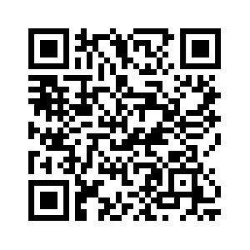

Registration now open:
31st Seminars on Audition
Assessment and Management
of the Tinnitus Patient
Saturday, February 22, 2020
North York Novotel,
3 Park Home Avenue, Toronto, ON
9:00 am – 4:30 pm
Rate includes Continental breakfast (8 to 9 am) and Lunch
Featured speakers:
Rich Tyler, Ph.D., University of Iowa:
Tinnitus Assessment and Management
Rex Banks, Au.D., Canadian Hearing Society:
Tinnitus in Canada
Sarah Hayes, Ph.D. Au.D., Western University:
The Neurophysiology of Tinnitus
Brandon Paul, Ph.D., Sunnybrook Hospital:
Tinnitus with a Normal Audiogram
And a Panel Discussion
with Clinicians, Researchers, and Attendees
https://conference.has.uwo.ca/Register/default.aspx?code=C000747

