Slide 1

Partnering with International Research Organizations & the Process
October 2021
NIH Regional Seminar
Emily Linde
Director, Grants Management Program
National Institute of Allergy and Infectious Diseases, National Institutes of Health
Glen C. McGugan, Jr., Ph.D.
Program Officer, Parasitology and International Programs Branch
Division of Microbiology and Infectious Diseases
National Institute of Allergy and Infectious Diseases, National Institutes of Health

Slide 2
NIH and International Research
Why does NIH support international research?

Slide 3
NIH and International Research
Why NIH supports international research:
  Application presents special opportunities for furthering research programs through the use of unusual talents, resources, populations, or environmental conditions not available in the U.S. or that augment existing U.S. resources.
  Specific relevance to the mission and objectives of the awarding IC and has the potential for significantly advancing the health sciences in the U.S.

Slide 4
Task Force on Microbiology and Infectious Diseases, 1991
“Because infectious diseases do not respect national boundaries and because many diseases can be studied and ultimately controlled only through integrated, global research programs, the Institute should continue its longstanding efforts to foster, support, and expand (where possible) broad-based international studies of infectious diseases….”

Slide 5
NIH and International Research
How NIH invests globally:
  Direct foreign awards
  Domestic awards with foreign components
Fiscal Year | Direct Foreign Awards | Domestic Awards with Foreign Component
2017 | 498 | 6345
2018 | 544 | 6958
2019 | 548 | 7512
2020 | 586 | 8348

Slide 6
NIH and International Research
Am I eligible to apply for NIH funding?

Slide 7
Application: Eligibility
  Review Funding Opportunity Announcement (FOA) for Eligibility
    Foreign Institutions may or may not be eligible
    Foreign components may not be allowed
    Foreign components may or may not be required
    Foreign applicants required to submit detailed budgets
  Contact NIH program staff

Slide 8
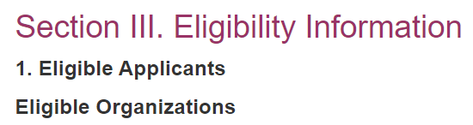
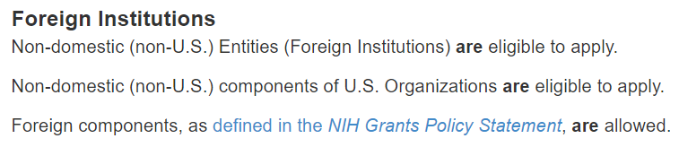
Application: Eligibility
Review Funding Opportunity Announcement (FOA) for Eligibility

Slide 9
Unsolicited versus Solicited (RFA) grants
 | Unsolicited | Solicited
Deadlines | Three deadlines/cycles per year | A single deadline
Review | CSR reviews | ICs review
Resubmissions | Many resubmissions allowed | No revisions/resubmissions
Letter of intent | No | Recommended
Purpose | Researchers pursue their own research interest | To address a high priority or under-represented area
Funding | Institute sets payline | Set aside funds

Slide 10
funding mechanisms
International Research Scientist Development
International Research Training
Emerging Global Leaders
D43
K01
K43
Multi-project
AREA
Small
HR/HR
MERIT
T32
F31
F32
K22
K99
R15
R03
R21
R01
U01/U19
R37
Graduate student
Postdoc
Independent
Research Supplement

Slide 11
Application: Eligibility
  Foreign organizations are generally not eligible to apply for these types of grants:
    Kirschstein-NRSA institutional research training
    Program project
    Center
    Resource
    SBIR/STTR
    Construction grants
  Note, some activity codes, such as program project grants (P01), may support projects awarded to a domestic institution with a foreign component.

Slide 12
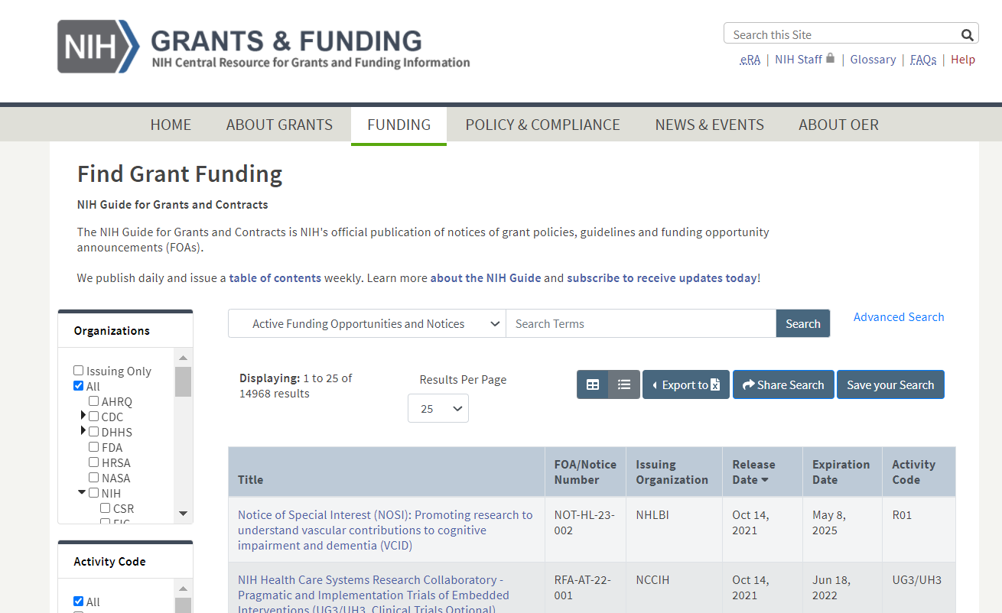
Search for Funding Opportunity
https://grants.nih.gov/funding/searchguide/index.html#/

Slide 13
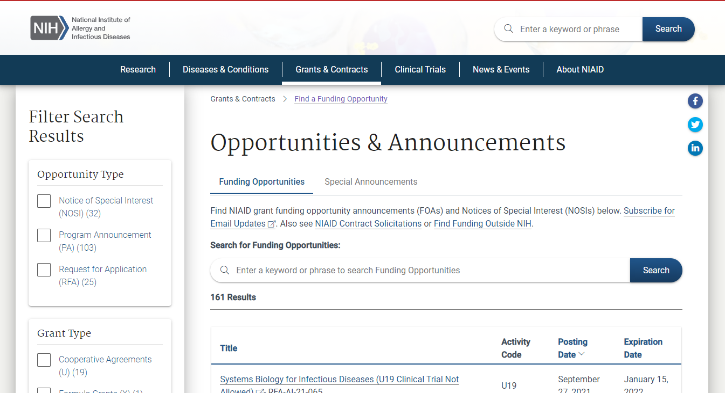
Search for Funding Opportunity
https://www.niaid.nih.gov/grants-contracts/opportunities

Slide 14
Application: Agency Contacts
FOA EXAMPLE:
Section VII. Agency Contacts
We encourage inquiries concerning this funding opportunity and welcome the opportunity to answer questions from potential applicants.
Scientific/Research Contact(s)
Paula S. Strickland, Ph.D., MPH
National Institute of Allergy and Infectious Diseases (NIAID)
Telephone: 240-669-2922
Email: pstricklan@mail.nih.gov
Peer Review Contact(s)
Louis A. Rosenthal, Ph.D.
National Institute of Allergy and Infectious Diseases (NIAID)
Telephone: 240-669-5070
Email: rosenthalla@niaid.nih.gov
Financial/Grants Management Contact(s)
Tseday Girma, MPA
National Institute of Allergy and Infectious Diseases (NIAID)
Telephone: 240-747-7388
Email: Tseday.girma@nih.gov

Slide 15
NIH and International Research
Are there different requirements for direct foreign applications and domestic applications with foreign component?

Slide 16
Definition of Foreign Component
Performance of any significant scientific element or segment of a project outside of the United States, either by the grantee or by a researcher employed by a foreign organization, whether or not grant funds are expended.
Activities that would meet this definition include, but are not limited to:
  Involvement of human subjects or animals
  Extensive foreign travel by grantee project staff for of data collection, surveying, sampling, and similar activities
  Any activity of grantee that may impact U.S. foreign policy through involvement in affairs or environment of a foreign country
Examples of other grant-related activities that may be foreign components:
  Collaborations with investigators at foreign site anticipated to result in co-authorship
  Use of facilities or instrumentation at a foreign site
  Receipt of financial support or resources from a foreign entity
Foreign travel for consultation not considered a foreign component

Slide 17
NIH and International Research
What is the likelihood I will get NIH funding?

Slide 18
Application: Success
Getting Started
https://grants.nih.gov/grants/grants_process.htm
Choose an appropriate topic
Write a strong proposal that addresses review criteria
Should be important (High Impact)
Topic must be unique
Must align with NIH/IC Mission
  Speak with NIH Program Staff
Identify a funding opportunity announcement (FOA)
https://grants.nih.gov/grants/what-does-nih-look-for.htm

Slide 19
NIH reporter
Make use of tools like RePORTER
  Applicable for US and Foreign researchers
Search based on
  Key terms
  PI
  Study Section
  Program Officer
https://reporter.nih.gov/

Slide 20
Tips for Foreign Investigators
  Speak with NIH Program staff about your idea and where it may best fit
  Things review group may consider
    Publication record
    Previous funding (best if from NIH)
    Justification of foreign site
Eligible does not equal competitive

Slide 21
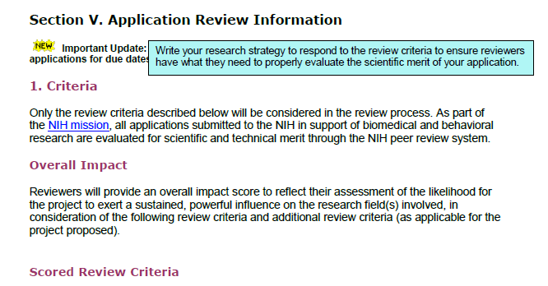
Application: Review Criteria
  Each FOA specifies all review criteria and considerations that will be used in the evaluation of applications submitted for that FOA.
Your application should respond to the review criteria listed in the FOA

Slide 22
Be persistent
remember
    ~50% of applications are “triaged”
    Read your critiques carefully
    contact program staff for advice
    decide the best route forward
      Fix weaknesses and resubmit application
      Submit a new application

Slide 23
NIH and International Research
What are basic needs for submitting an application?

Slide 24
Foreign Institution Registrations
Grants.gov and NIH eRA Commons
  Must register prior to application submission
Data Universal Number System (DUNS)
  Changing by April 2022 (NOT-OD-21-170)
System for Award Management (SAM) – renewed annually
NATO Commercial and Government Entity (NCAGE)
https://grants.nih.gov/grants/foreign/index.htm
HHS Payment Management System, required only if funded.
NOTE: PMS Registration must match SAM or funds cannot be drawn

Slide 25
DUNS/UEI
Federal-wide transition from DUN and Bradstreet (D&B) Data Universal Numbering System (DUNS) number to a new government-owned Unique Entity Identifier (UEI) by April 2022.
Implementation
  October 2021
    Entities registered in eRA Commons will begin to see UEI populated in their Institutional Profile File (IPF).
      No action is required by the entity.
  For applications due on or after January 25, 2022
    Applicants must have UEI at time of application submission. See NOT-OD-21-169

Slide 26
Foreign Institution Registration
EIN
  For applications, if your organization is not in the United States, enter 44-4444444.

Slide 27
Do I Contact NIH Before Applying?
Mandatory:
  Application with budget >$500,000 direct costs (excluding consortium F&A) for any budget period.
    Does not apply to applications submitted in response to RFAs or other announcements that include specific budgetary limits.
Optional:
  When RFA’s request a Letter of Intent
  Recommended when submitting any application

Slide 28
NIH and International Research
What can I put in my budget?

Slide 29
Budget Considerations
Needs to be appropriate for the science
Foreign site salary norms
Procurement and availability of research supplies
Currency exchange rates

Slide 30
Budget Considerations
NIH Grants Policy Statement (GPS) section 7.9.1 provides a subset of common, allowable costs. The list is not all inclusive.
NIH GPS Section 16.6 provides unallowable costs and grant requirements for foreign grantees and foreign components.
  Unallowable Costs
  Major alterations and renovations (A&R). Costs for major A&R (>$500,000).
  Patient Care Costs are provided only in exceptional circumstances.
  Grantees are reminded that they may not invest grant funds to defray the cost of inflation.

Slide 31
Budget Considerations
Consult NIH Grants Policy Statement for policies and compliance requirements
Have SOPs
Follow four cost principles:
  Reasonableness – The dollar amount is within the limitations that a prudent person would pay for the good or service.
  Allocability – The goods or services that can be assigned directly to the grant.
  Consistency – Routinely applied to the same category.
  Conformance – Test of allowability. Grants costs
    must conform to the “Allowability of costs/Activities” section of the NIH Grants Policy Statement.

Slide 32
F&A for Foreign Awards
Necessary costs incurred by a recipient for a common purpose benefitting more than one cost objective, and not readily assignable to specifically award.
Supports cost of compliance with federal requirements
  E.g., protection of human subjects, animal welfare, invention reporting, other post-award reporting requirements, financial conflict of interest and research misconduct.

Slide 33
F&A for Foreign Awards
8% of modified total direct costs (MTDC)
  exclusive of tuition and related fees
  direct expenditures for equipment
  subawards in excess of $25,000

Slide 34
Calculating F&A for Foreign Award
Total Direct Cost to Foreign Prime: $290,000
  Including Equipment Cost: $9,000
  Including 1 Subaward: $30,000 total cost
MTDC Calculation:
$290,000 (Total Direct Costs)
- $9,000 (Equipment)
- $5,000* (In Excess of Subaward Allowance)
= $276,000
F&A Calculation: $276,000 x 8% = $22,080
Total Cost calculation: $290,000 TDC + 22,080 (F&A) = $312,080
Subtraction Method
$30,000 (Subaward Total Costs)
- $25,000 (Subaward Allowance)
= $5,000 (In Excess of Subaward

Slide 35
Calculating F&A for Foreign Award
Direct Cost at Foreign Prime: $260,000
Including Equipment Cost: $9,000
subaward total costs $30,000 total cost
  290,000
MTDC Calculation:
$260,000 (Total Direct Costs)
- $9,000 (Equipment)
+$25,000* (In Excess of Subaward Allowance)
= $276,000
F&A Calculation: $276,000 x 8% = $22,080
Total Cost calculation: $290,000 TDC + 22,080 (F&A) = $312,080
Addition Method

Slide 36
NIH and International Research
What are the requirements for a collaboration/subawards?

Slide 37
Funding Collaborations
Traditional Subcontract/Consortium
  U.S. Institution is responsible
  Requires a formalized written agreement
  Substantial scientific involvement
  Ensure the collaborating organization(s) understand the rules and regulations
  Determine who has the authority to sign for the organization
    Local hierarchy in foreign organization

Slide 38
Funding Collaborations
Traditional Subcontract/Consortium
  Decide how and when the funds will be disbursed
    Understand local reimbursement systems
    Salary support for local investigators
    Project delays = no salary support for staff
    Check or Wire payments
    Advance payments
  Establish procedures for reporting progress and use of funds
  U.S. awardees will flow down to foreign subrecipients applicable parts of the Uniform Guidance and monitor foreign entity progress

Slide 39
Overarching Considerations
Foreign Institutions function differently
    Language
    Time Zones
    Internet Access
    Sponsored programs staff
    NIH funding requirements
Plan for delays, differences and dialogue Apply early

Slide 40
NIH and International Research
What are the reporting requirements?

Slide 41
Project Monitoring
Research Performance Progress Report (RPPR)
  Section E.4--What dollar amount of the award’s budget is being spent in foreign country(ies)?
      Domestic awardees provide dollar amount obligated to first-tier subawards to foreign entities
      Foreign awardees provide dollar amount of award excluding first-tier subawards to U.S. entities
      Dollars should reflect Total Costs
      For multiple foreign countries, include distribution between foreign countries
      Foreign travel and purchases not necessary unless part of first-tier sub

Slide 42
Project Monitoring
Research Performance Progress Report (RPPR)
  Section G.9 Foreign Component—Provide information on foreign components
      Significant scientific activity performed outside of the U.S. whether or not grant funds were expended
      NIAID adds a Term of Award to NoA to remind Grantees that research conducted outside the Unites States needs to be reported
  D.1 – Participants
    Check “yes” and add the organization/country if the individual’s primary affiliation is foreign and working in a foreign country

Slide 43
Tips for Foreign Investigators
Don’t forget about the Audit Requirements – required if expended $750,000 or more in HHS awards.

Slide 44
Closeout
Documents are due within 120 calendar days of the end of grant support:
  Final Federal Financial Report (FFR) SF-425 Expenditure Data (submitted through eRA Commons);
    Grantees must ensure there are no discrepancies between final FFR expenditure data and Payment Management System.
      Obligated funds must be drawn prior to 120 days after project period end date
    Reconcile award and expenditures
      Review carefully for restricted funds or carryovers
  Final Invention Statement & Certification;
  Final RPPR (F-RPPR) and Interim-RPPR

Slide 45
NIH and International Research
What if I want to make changes?

Slide 46
Prior Approval
Change in Scope
Change of PD/PI or Institution
  Reduction of effort by 25% or more
Carryover of unobligated balances
  required if NoA includes a term and condition of award
Change or addition of a performance site within a foreign country

Slide 47
Prior Approval
Transfer of a grant from foreign organization to domestic organization
Transfer of a grant to or between foreign or international organizations
  Requires approval of the NIH and National Advisory Council or Board.
Contact NIH Program Officer/Grants Management Specialist for prior approvals

Slide 48
NIH and International Research
What else do I need to consider?

Slide 49
Institutional FCOI Policy
Since November 12, 2020, NIH funded recipients are required to submit their publicly accessible Financial Conflict of Interest (FCOI) policy to NIH via the eRA Commons Institution Profile (IPF) Module (IPF Module).
See NIH Grants Policy Statement Section 4.1.10 for all FCOI policies.

Slide 50
Key Take-Aways
Review the Notice of Award (NoA) for funding information and to determine:
  Streamlined Noncompeting Award Process (SNAP) vs. non-SNAP
  Automatic carryover authority
Federal Financial Report (FFR)
  For non-SNAP awards - required annually
  For SNAP awards - required at end of the competitive segment

Slide 51
Key Take-Aways
Communication
  Most foreign institutions need assistance in understanding NIH requirements
Understand their unique policies, regulations and practices
Be involved for the long term
Be patient

Slide 52
Thank you!
THANK YOU!
Emily Linde
lindee@mail.nih.gov
Glen C. McGugan, Jr., Ph.D.
gmcgugan@niaid.nih.gov

Slide 53
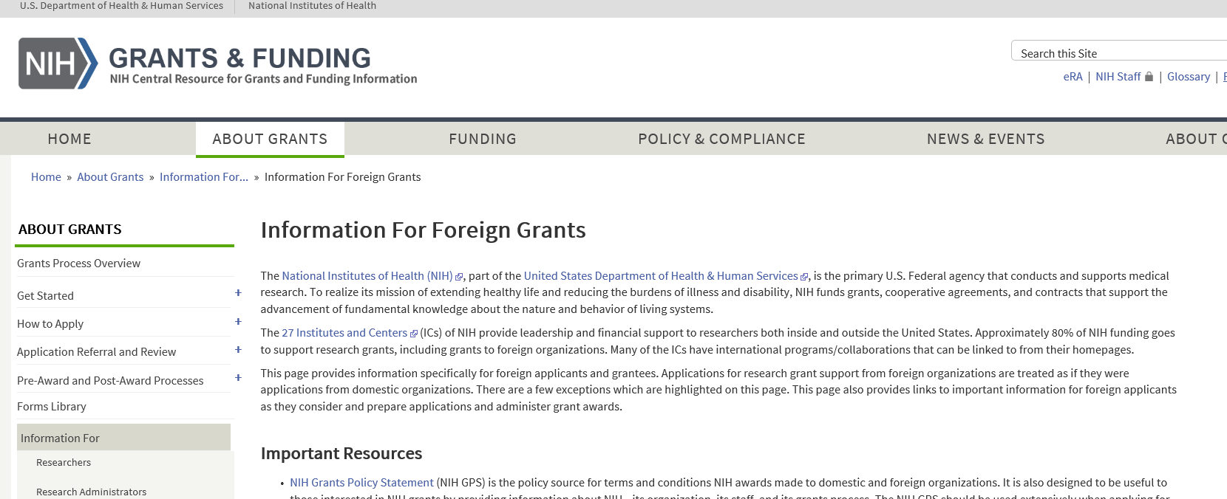
Information for Foreign Grants
https://grants.nih.gov/grants/foreign/index.htm

Slide 54
Human Subject Research
  Recipient is accountable
  Federal wide Assurance (FWA) and Institutional Review Board (IRB) rules apply to international
    domestic sites of multi-site studies that will conduct same protocol involving non-exempt human subjects research must use a single Institutional Review Board (sIRB)
  Some countries have in-country requirements
  National ethical reviews may be required

Slide 55
Human Subject Research
Revised Common Rule (45 CFR 46)
January 21, 2019, studies initiated on or after that date, ongoing studies that voluntarily transitioned to the Revised Common Rule, and studies that voluntarily implemented the three burden-reducing provisions during the delay period (7/19/18 – 1/20/19), are expected to comply with all Revised Common Rule requirements for the remainder of the study.
New Exemption Codes “X” for applications submitted on or after 1/25/19
Changes to IRB review criteria, IRBs are now required to review and approve the research protocol.
Resources:
  Protection of Human Subjects
  NOT-OD-19-050
  Application Guide

Slide 56
Human Subject Research
  NIH discontinued support of the Protecting Human Subjects Research Participants (PHRP) training.
  September 26, 2018 was the last available date for the training online
  Per policy, NIH does not endorse any specific program to fulfill requirements.
  Responsibility of fulfilling PHRP Requirements lies with the institution.
  It is up to the institution to determine what constitutes as “appropriate training.”
  FAQ section is being created for the OEP website.
  References: NOT OD-00-039, NOT OD-18-221, PHRP website

Slide 57
Vertebrate Animal Research
  Recipient is accountable
  Animal Welfare Assurance (AWA) required
  Foreign site must provide domestic recipient with verification of IACUC approval
  Foreign recipients provide OLAW with an Animal Welfare Assurance
    IACUC approval is not required for direct foreign awards

