Slide 1

Ready, Set, Submit!
GRANT Application Preparation & Submission
Kasima Garst, OER/OPERA/SPB
Laurie Roman, OER/eRA

Slide 2
Take Home Messages
PATSA- (think PASTA with a Boston accent) -Plan Ahead To Stay Ahead
Make sure all your registrations are in place and you know your commons ID and password
READ the FOA! Application instructions guide<FOA<Notices
Know what submission system your organization uses (ASSIST, workspace, S2S)
Build your team, establish responsibilities
Complete the application- NIH recommends submitted early to ensure on time submission- Early is on a calendar NOT a clock
If you can’t see the grant image, we can’t see the grant image, which means we can’t review it and can’t fund it- correct all errors!
NIH staff and reviewers also check for compliance to policies

Slide 3

NIH Grants and Funding https://grants.nih.gov/
How to Apply- Application Guide

Slide 4
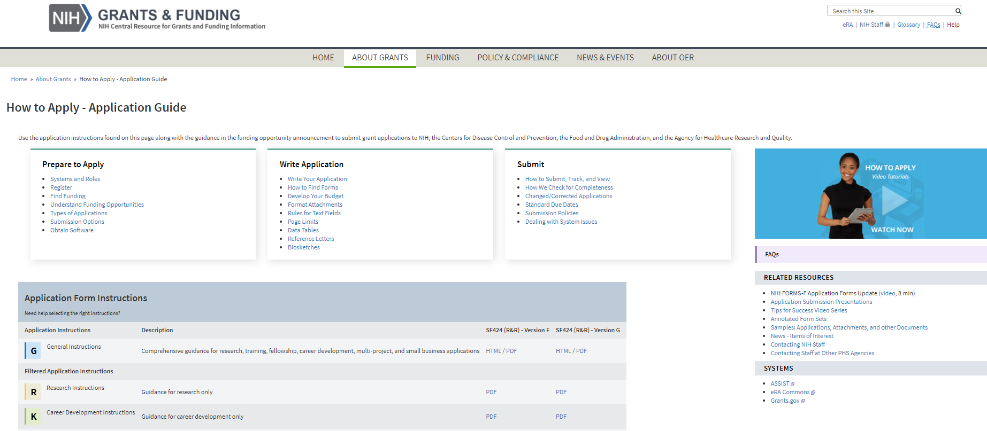
How to Apply – Application Guide https://grants.nih.gov/grants/how-to-apply-application-guide.html
General Application Process Information
Form Instructions
Resources

Slide 5
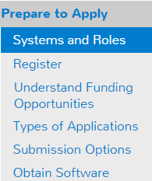


Understand Key Systems & Roles
https://grants.nih.gov/grants/how-to-apply-application-guide/prepare-to-apply-and-register/key-systems-and-roles.htm
Grants.gov
eRA Commons
E-Business Point of Contact (EBiz POC)
Authorized Organization Representative (AOR)
Signing Official (SO)
Principal Investigator (PI)

Slide 6
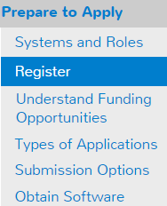


Organization Registration
https://grants.nih.gov/grants/how-to-apply-application-guide/prepare-to-apply-and-register/registration/org-representative-registration.htm
Your organization must be registered in multiple systems to submit.
Start early – can take 6 weeks!
DUNS – provides unique organization identifier *
UEI (Unique Entity Identifier)- DUNS replacement, needed for submissions to NIH for due dates on or after 1/25/2022 (NOT-OD-21-170)
SAM (System for Award Management) – needed to do business with government
  Requires annual renewal
Grants.gov – required to submit grants
eRA Commons – required to do business with NIH
SBA (Small Business Administration) – required
for SBIR/STTR applications

Slide 7
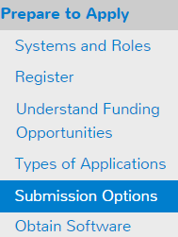




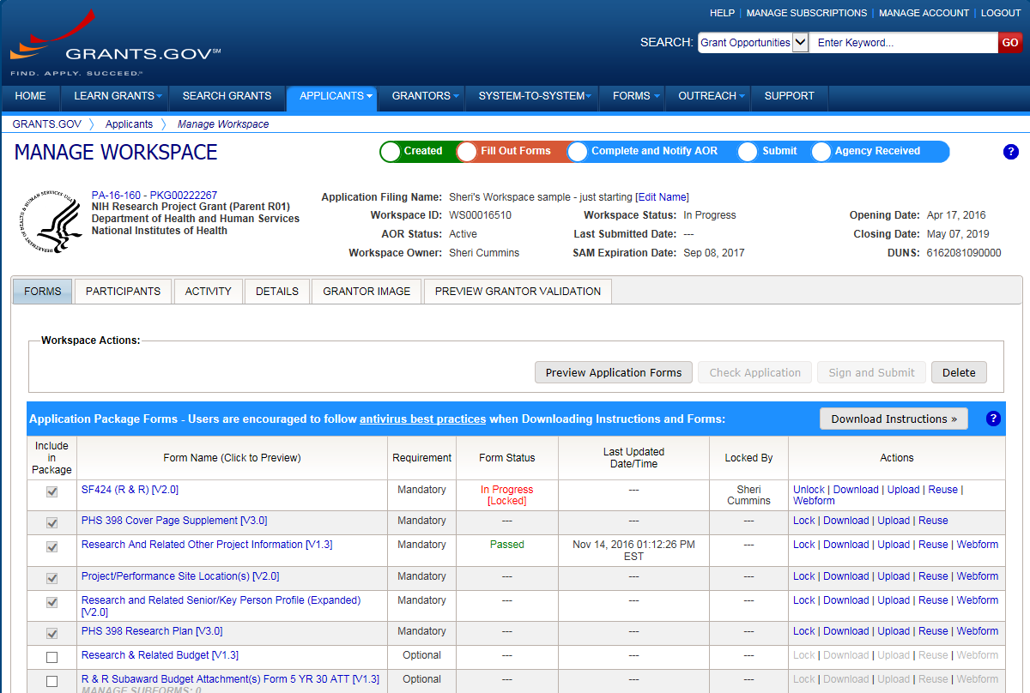




Application Submission Options
https://grants.nih.gov/grants/how-to-apply-application-guide/prepare-to-apply-and-register/choose-a-submission-option.htm
44%
50%
6%
ASSIST
System-to-System
Workspace
Managed by NIH
Leverages eRA Commons accounts
Pre-population from eRA Commons profiles
Track application status in single system
Supports all NIH competing applications
Pull study information from ClinicalTrials.gov
Integrated NIH messaging (tips, system alerts)
Managed by Grants.gov
Requires additional user registrations
No Pre-population from existing profiles
Must track application in multiple systems
Supports all NIH single- project competing applications (no multi-project support)

Slide 8



Your Application will be…
Subject to the same registration requirements
Completed with the same data items
Routed through Grants.gov
Validated against the same NIH business rules
Assembled in a consistent format for review consideration
Tracked in eRA Commons
…regardless of submission option used.

Slide 9
Application Forms
There is NOT a universal set of application forms that can be downloaded from our form library or websites
You must use the application form package attached to your funding opportunity announcement
  Each application form package includes the customized subset of forms supported by NIH which are needed for that opportunity
Application forms are accessed using your chosen submission method

Slide 10








Now Let’s Talk About the Application Process
Step 1: Find
Step 2: Plan
Step 3: Initiate
Step 4: Build team
Step 5: Enter data
Step 6: Finalize
Step 7: Submit
Step 8: Track

Slide 11

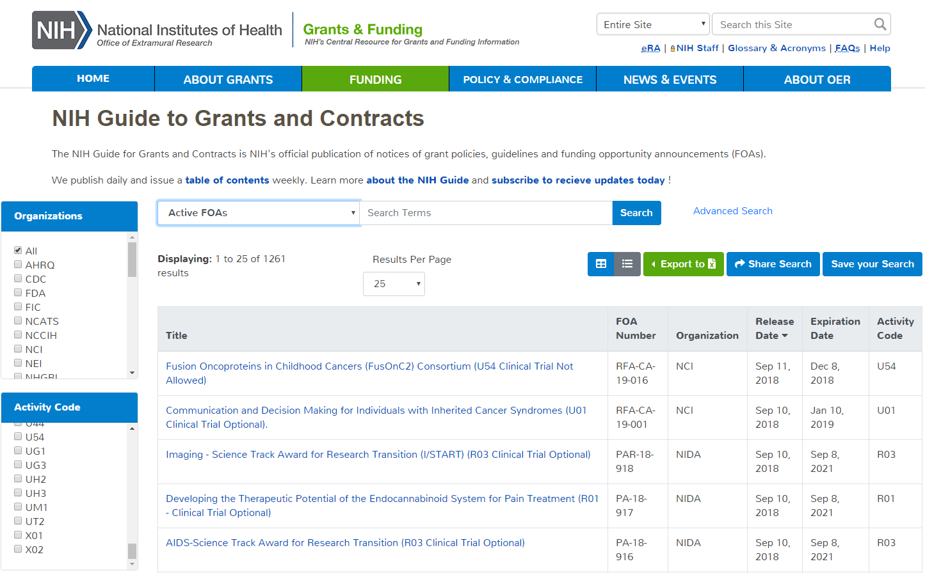
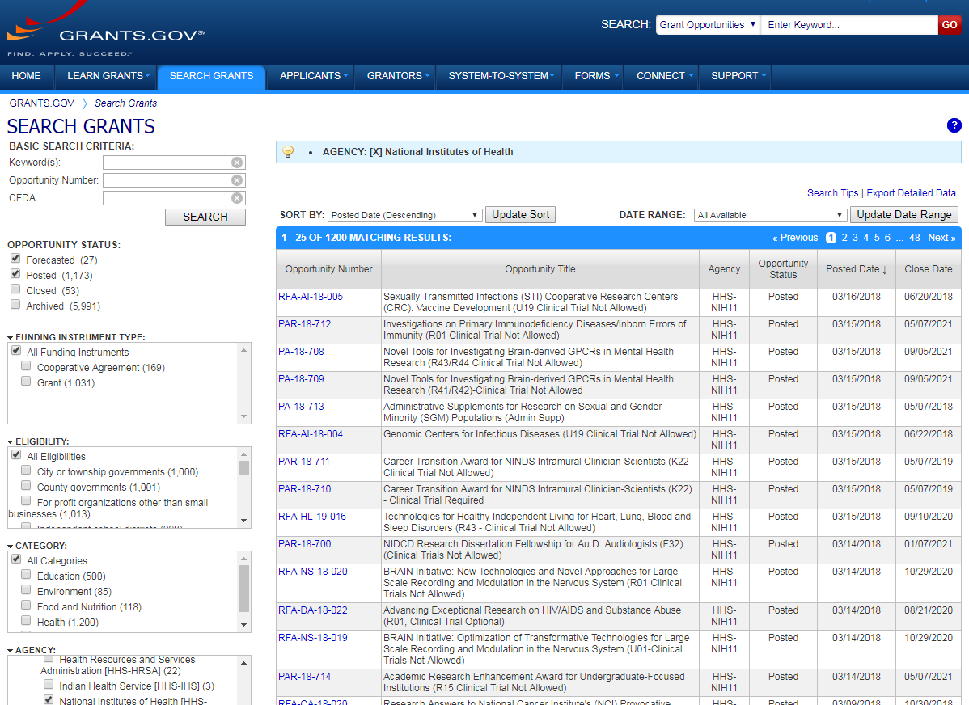
Step 1: Find an Opportunity of Interest
NIH Guide for Grants & Contracts
Grants.gov Search Grants

Slide 12

Carefully Read the Entire Funding Opportunity Announcement (FOA)
Part 1- Overview Information
  Participating Organizations
  Related Notices
  Key Dates
Part 2- Full Text of Announcement
  Section I. Funding Opportunity Description
  Section II. Award Information
  Section III. Eligibility Information
  Section IV. Application and Submission Information
  Section V. Application Review Information
  Section VI. Award Administration Information
  Section VII. Agency Contacts
  Section VIII. Other Information

Slide 13

Step 2: Plan for Your Submission
Identify team members
Verify registrations are in place and active
Choose submission method
Determine application preparation responsibilities
  Who will – prepare budget, gather data, create attachments, do data entry
Make sure everyone is aware of process
  Internal review & approval process
  Post-submission responsibilities
    How to deal with errors/warnings
    Who will verify application in eRA Commons?

Slide 14

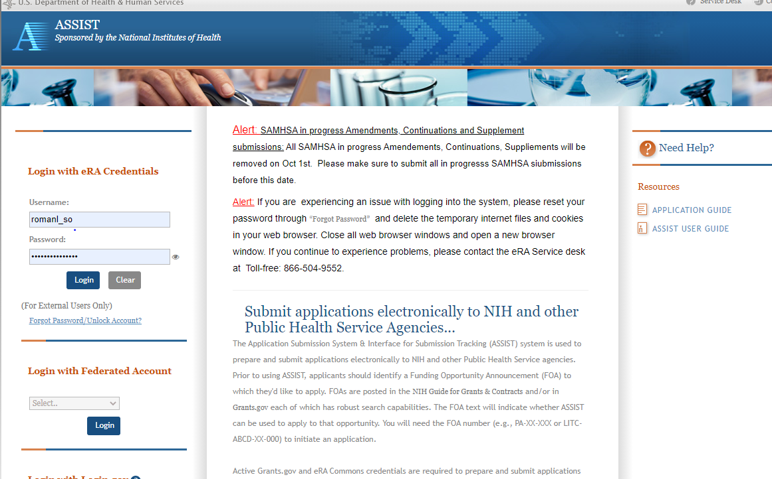
Step 3: Initiate Application
Login to your submission system and initiate your application and access the application forms
ASSIST | Workspace
Initiate Application | Create Workspace

Slide 15

Step 4: Build Your Team
Provide application access to appropriate team members
  Gather eRA Commons usernames to include in your application for all individuals listed on the Sr Key Personnel form (NOT-OD-21-109) including:
  Project Director/Principal Investigators (PD/PIs)
  Component leads on a multi-project application
  Sponsor on a fellowship application
  Candidates for diversity and re-entry supplements
  Primary mentor on individual mentored career development application
  Can control access to specific sections of the application such as budgets
ASSIST | Workspace
Gather eRA Commons usernames and use Manage Access to give folks access | Gather Grants.gov usernames and use Participants tab to give folks access

Slide 16

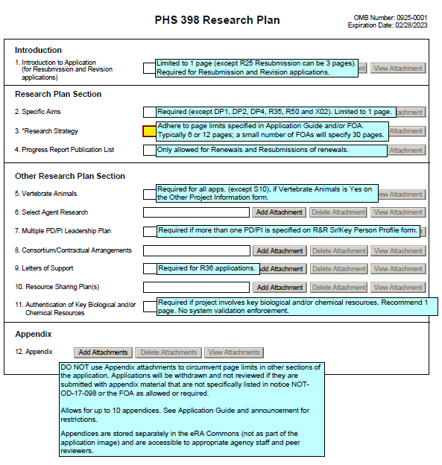
Step 5: Enter Data https://grants.nih.gov/grants/how-to-apply-application-guide.html
Follow All Guidance
Handy Resource
Notices in NIH Guide for Grants & Contracts including Notices of Special Interest (NOSIs)
Funding Opportunity Announcement
  Section IV. Application and Submission Information
How to Apply - Application Guide
Annotated form sets
Precedence / Importance

Slide 17
Application Attachments https://grants.nih.gov/grants/how-to-apply-application-guide/format-and-write/format-attachments.htm
Use simple PDF-formatted files for all attachments. Forms with fillable fields or signatures must be flattened
  Disable security features such as password protection
Use new versions of Biosketch and Other Support Templates (NOT-OD-21-073)
Keep file names to 50 characters or less
Filenames must be unique within the application
Use meaningful filenames, especially for “Other Attachments”
Do not include headers or footers
  Section headings as part of the text (e.g., Significance, Innovation, Approach) are encouraged
Follow specified page limits
Follow guidelines for fonts and margins
Follow guidelines for hyperlinks and URLs

Slide 18

Step 6: Finalize Your Application
Action | ASSIST | Workspace
6a. Run a pre-submission validation check | Validate Application | Preview Grantor Validation
6b. Generate a pre-submission image of your assembled application in the NIH format | Preview Application | Grantor Image
6c. Take any additional steps needed to prepare for Submission | Update Submission Status to “Ready to Submit” | Complete and Notify AOR (optional)

Slide 19

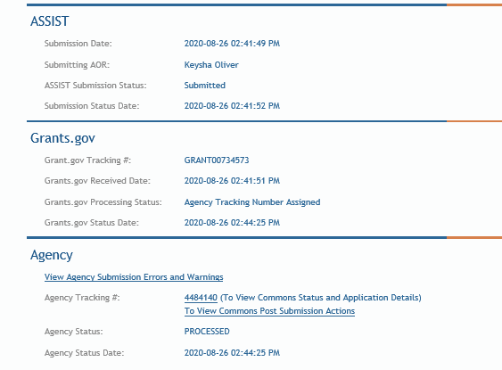
Step 7: Submit Your Application
Follow steps for your submission method
Only folks with Grants.gov AOR (Authorized Organization Representative) credentials can submit
All NIH applications route through Grants.gov
Your Grants.gov timestamp
is used to determine
“on-time” submission
Grants.gov Tracking #
Date/Time Stamp – always recorded in Eastern Time

Slide 20

On-time Submission
Deadline = 5 p.m. local time of submitting organization on the due date
  All registrations and SAM renewal must be completed before the deadline
  Application must be free of all federal system-identified errors (Grants.gov & eRA)
  NIH’s late policy does not allow corrections after the deadline
  NIH recommends submitting early to allow time to correct any unexpected errors or submission issues

Slide 21

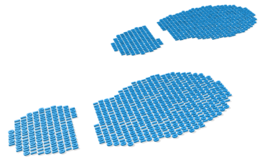
Step 8: Track Your Application
eRA Commons Status is an integral part of your submission
  Applications that pass Grants.gov validations are picked up by eRA Commons and checked against many application guide and opportunity instructions
Authorized users can check eRA Commons Status for processing results
  Signing Officials (SOs)
  Administrative Officials (AOs)
  Principal Investigators (PIs)
  Delegated Assistants (ASSTs)
E-mail notifications sent
  DO NOT depend solely on email notifications
  It is YOUR responsibility to proactively check your application status in eRA Commons

Slide 22


Errors & Warnings
Corrective submissions must be made BEFORE the submission deadline and overwrite previous submissions
  Errors stop application processing and must be corrected
  Warnings do not stop application processing and are corrected at your discretion based on your circumstances

Slide 23

Correcting Errors Found After Submission https://grants.nih.gov/grants/how-to-apply-application-guide/submission-process/changed-corrected-application.htm
To correct system-identified errors found after submission:
Make corrections to local copy of the application
Update SF424 (R&R) form
  Check “Changed/Corrected” as “Type of Submission”
  Enter “Previous Grants.gov Tracking ID” (e.g., GRANT12345678) in field 4c
Submit the entire Changed/Corrected application back through Grants.gov before the deadline
Track submission through to eRA Commons
NOTE: Reviewers do not see applicant warnings, nor can they tell how many submission attempts were needed to complete the submission process

Slide 24
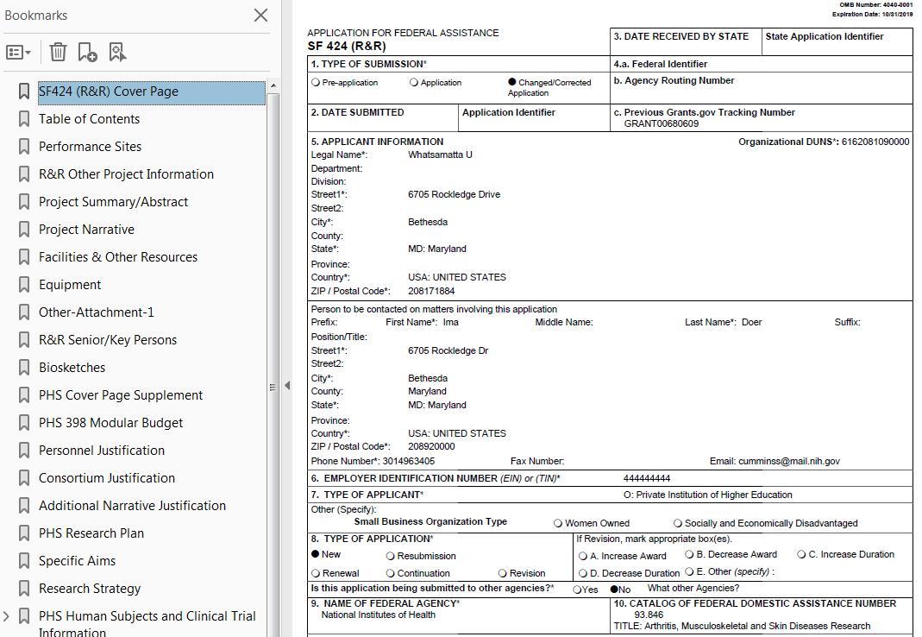
Application Assembled & Posted in eRA Commons
Once an error-free application is received by NIH, the eRA system will:
  Assemble the grant application image
  Insert headers (PI name) and footers (page numbers) on all pages
  Generate Table of Contents and bookmark important sections
  Post the assembled application image in the PD/PI’s eRA Commons account
  Send notifications

Slide 25
Application Viewing Window https://public.era.nih.gov/commons
Applicants have two (2) business days to view the assembled application image before the application automatically moves forward for further processing
SO can Reject application within viewing window to prevent it
from moving forward to NIH staff
  Can submit a Changed/Corrected application before the submission deadline
ASSIST | Workspace
View Submission Status Details link | Must login to eRA Commons directly and access the application’s detailed status screen

Slide 26

Submission Complete!
If you don’t reject within the two business day viewing window, the application automatically moves forward for further processing at NIH
Any subsequent application changes are subject to the NIH policy on late submission of grant applications and the NIH policy on post-submission application materials

Slide 27
Application Checks (Validations)
Grants.gov
eRA Systems
Agency Staff
Active System for Award Management (SAM) registration
Submitter has AOR role for DUNS on application
Submission made to active opportunity and application package
Virus check
Filenames include only appropriate characters
Fields required by agency, but not required federal-wide
  R&R Sr/Key form
    Credential for PD/PIs
    Organization name for all sr/key
    Biosketch for all sr/key
  Performance Site form
    DUNS for primary site (UEI for due dates on/after Jan 25, 2022)
Attachments in PDF format
Adherence to page limits in our Table of Page Limits
All appropriate attachments included
Fit with NIH/Institute mission
Eligibility
“Overstuffing”
On-time submission
Adherence to funding opportunity announcement specific instructions
Font, margin, and hyperlink guidelines
Simultaneous review of essentially same application

Slide 28
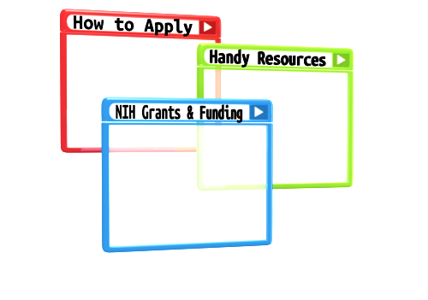
Resources

Slide 29
Help Desks
eRA Service Desk
Grants.gov Contact Center
Web: https://grants.nih.gov/support/
Phone: 1-866-504-9552
Hours : Mon-Fri, 7a.m. to 8 p.m. ET
Toll-free: 1-800-518-4726
Hours : 24x7 (Except Federal Holidays)
Email : support@grants.gov
Resources: https://www.grants.gov/web/grants/support.html

Slide 30
Online Resources & Websites
NIH Grants and Funding
https://grants.nih.gov/grants/oer.htm
How to Apply – Application Guide
https://grants.nih.gov/grants/how-to-apply-application-guide.html
Annotated form set
https://grants.nih.gov/grants/how-to-apply-application-guide/resources/annotated-form-sets.htm
Preparing Your Application Using ASSIST
https://grants.nih.gov/grants/how-to-apply-application-guide/prepare-to-apply-and-register/submission-options/assist.htm

Slide 31

Stay Connected – Subscribe to Listservs https://era.nih.gov/about-era/get-connected.htm
eRA-Information-L
  For administrators, principal investigators and the people that support them
  Used by NIH to notify the community of information related to eRA Commons, ASSIST and eSubmission
NIH_ESUB_SYS2SYS-L
  For technical personnel involved in system-to-system solution development and planning
  Used to exchange information related to the implementation of system-to-system solutions for grant application preparation and submission to NIH
ASSIST-Development-L
  For ASSIST users willing to share their individual perspectives on proposed ASSIST enhancements and options for addressing identified system issues

Slide 32

Questions?

